Slide 1
Natural Resource Overlay Amendment AMD2024-0004 & ZMA2024-0001 November 19, 2024 Presenters: Ryan Hostetter, Joint Long Range Planning Megan Smith, EcoConnect Consulting LLC
Jackson & Teton County Long Range Planning

Slide 2
Presentation Contents
Background
Tiered Map and How it was made
Layout and Framework of Regulations
Example Projects
Compare with current 1994 NRO
Waterbody & Wetland Section
Planning Commission & Changes
Q & A
Public Comment
Direction for additional revisions or information?
Next Meeting Date?

Slide 3
Background
This project was released for public review September 28, 2018
Project put on hold – several staff changes
Project resumed in 2020 and County retained Megan Smith of EcoConnect for assistance with finalizing
Project has been updated and amended
New and updated public comment/involvement

Slide 4
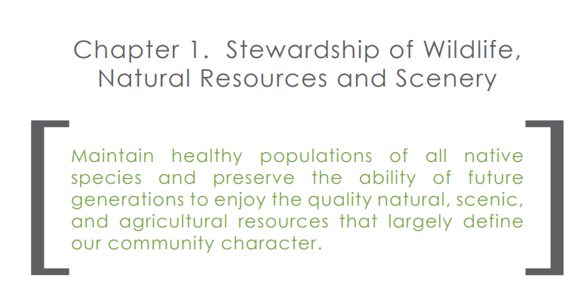
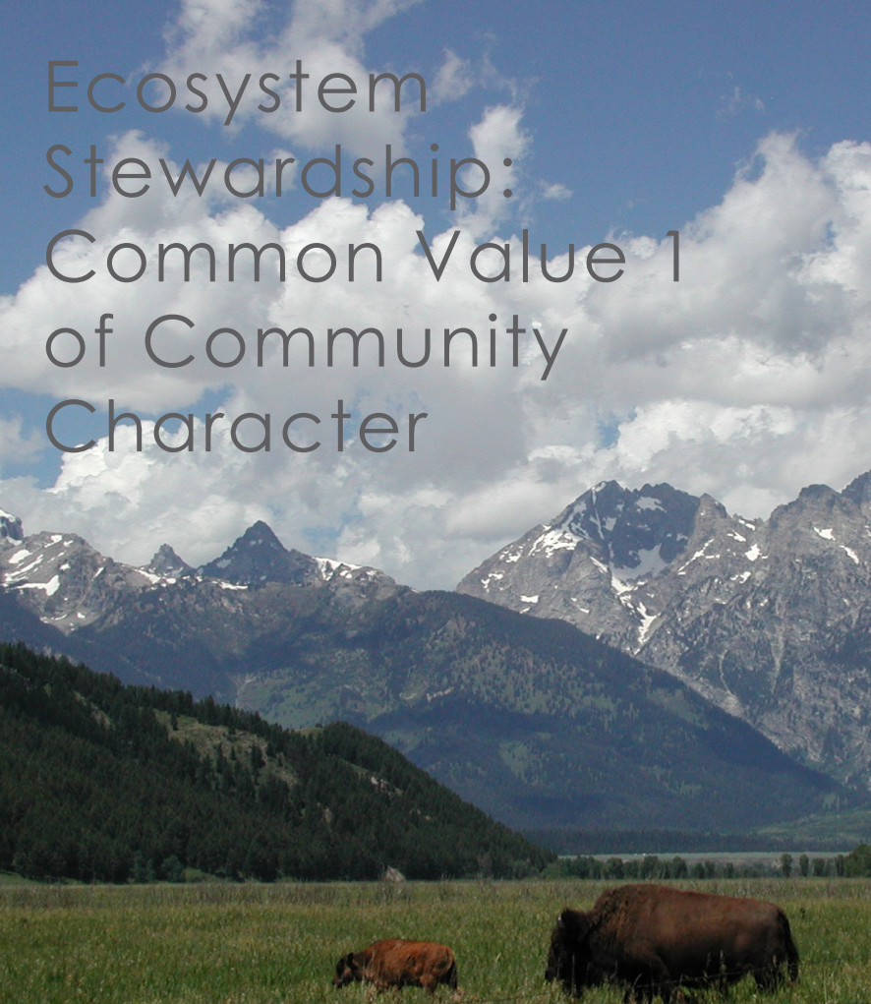
Background
Comprehensive Plan common values – Chapter 1 Ecosystem Stewardship (Policies 1.1.a Focal Species and 1.1.b. Wildlife)
3 sections in the Land Development Regulations regulate Natural Resources
5.1 General Environmental Standards
5.2 Environmental Standards Applicable in Specific Areas
8.2 Common Procedural Standards (Environmental Analysis procedures)

Slide 5
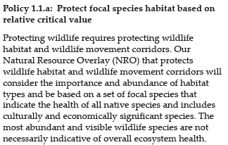
Background
2012 - Comp Plan Directive 1.1.a
1994 NRO and Tiered NRO are a LANDSCAPE level tools.

Slide 6
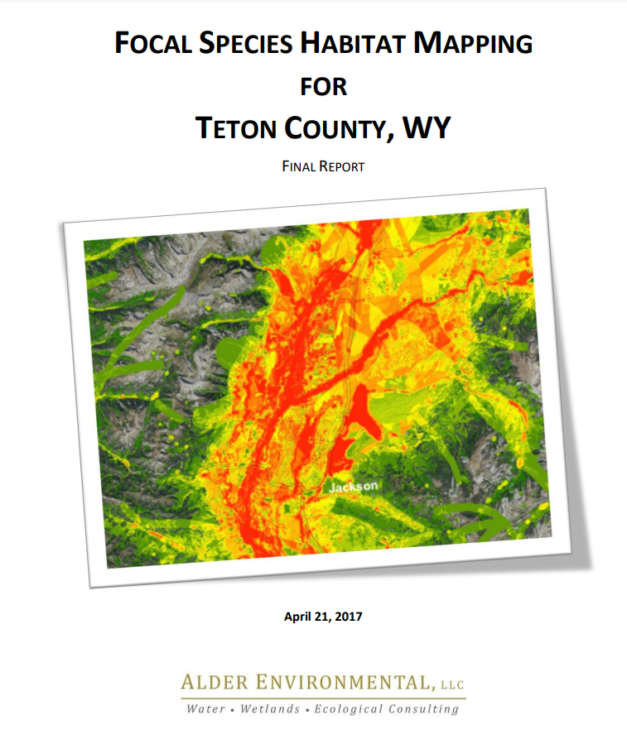
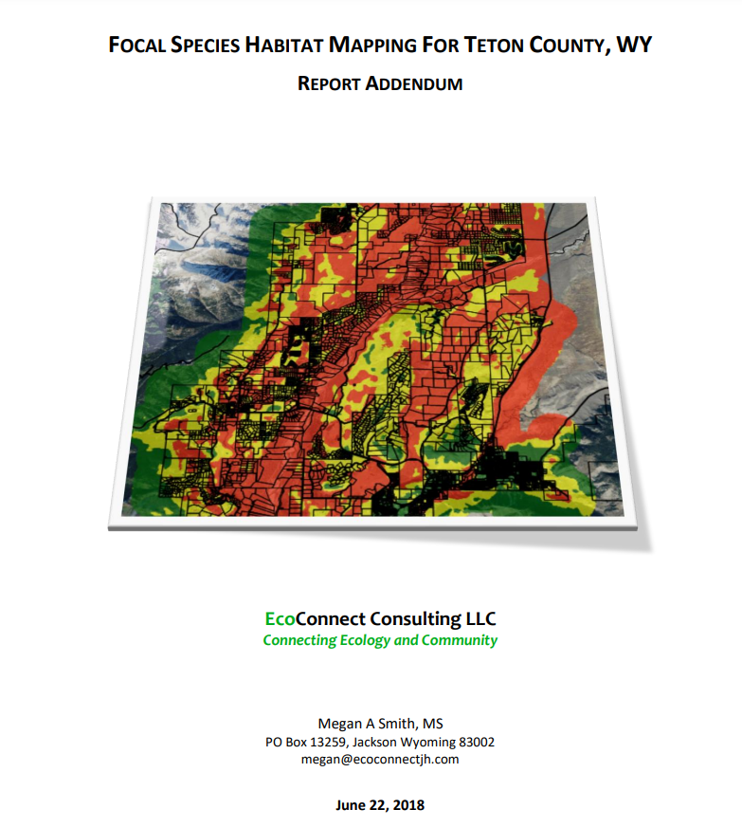

Slide 7
How was the tiered map created?
Presenter: Megan Smith EcoConnect

Slide 8
CURRENT PROCESS
Background
Div 5.1 applies to all properties in Teton County
Waterbodies & Wetlands
Div 5.2 Applies to Properties
in the NRO
In the NRO?
YES
NO
Complete
Environmental Analysis (EA)
inclusive of
Topics from Div 5.1 & 5.2
If Applicable:
Wetland Delineation (Aquatic Resources Inventory)
Alternatives Analysis
Complete
Zoning Compliance Verification (ZCV) for Environmental Standards
inclusive of
Water, wetlands, Trumpeter Swans, Trout, Bald Eagles

Slide 9
Prior to 2016
Focal Species selected by Natural Resources Technical Advisory Board (NRTAB) and TC Planning
2016
Focal Species List was refined to represent habitat types across Teton County
2016-2017
Focal Species Habitat Layers and Relative Values Habitat Map were produced – the basis of the Tiered NRO
Background

Slide 10
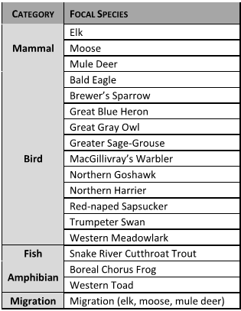
2016-2017 Process
Expert Participants
Natural Resources Technical Advisory Board (NRTAB)
WGFD Biologists
TC Planning Staff
Team including local researchers/ species experts

Slide 11
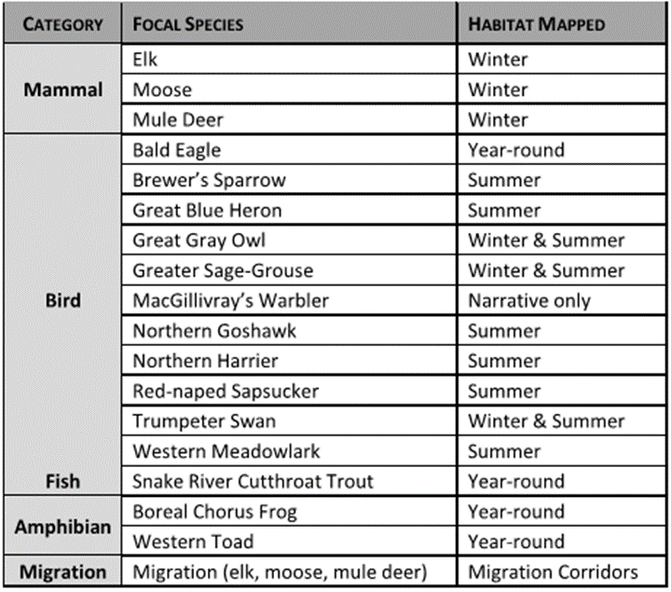
Focal Species
Species habitat narratives
written by specialist,
reviewed by experts and NRTAB
Created 20 Suitable Habitat Layers by Species

Slide 12
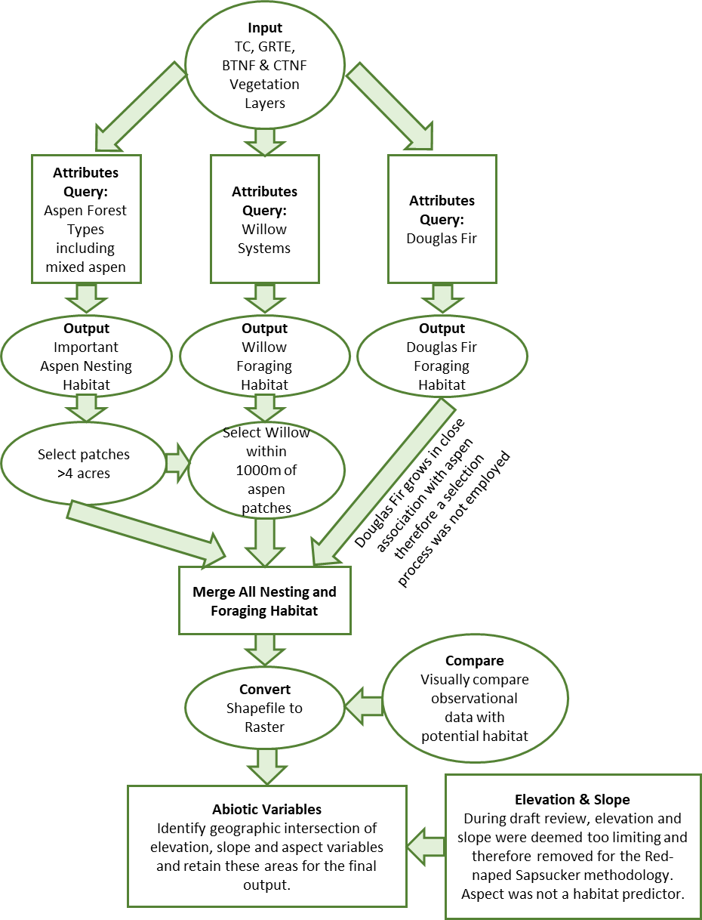
Habitat Characteristic | Selection Criteria
Aspen vegetative cover and mixed forest containing aspen component | Patch size >1.7 ha (4 ac); If available the number of trees >18 cm DBH (approx. 7 inches) would reflect a measure of available nest trees
Slope | 8.0 – 34.0% (17% average)
Elevation | Valley floor to approximately 9,000 ft. In GRTE, aspen phases out at ~9,500 ft. In Grand Junction CO elevations were 2,459-3,291m (8,000 – 10,800 ft).
Distance from aspen to riparian willow areas | 250 m (~800 ft)
Association with foraging vegetation (Douglas Fir and willow areas) within 16 ha (40 ac – approx. home range) | Percent aspen in a territory is positively correlated with nest productivity and available nest sites. Therefore, higher percentages of aspen could be an indicator of higher value habitat
Example Species: Red-Naped Sapsucker

Slide 13
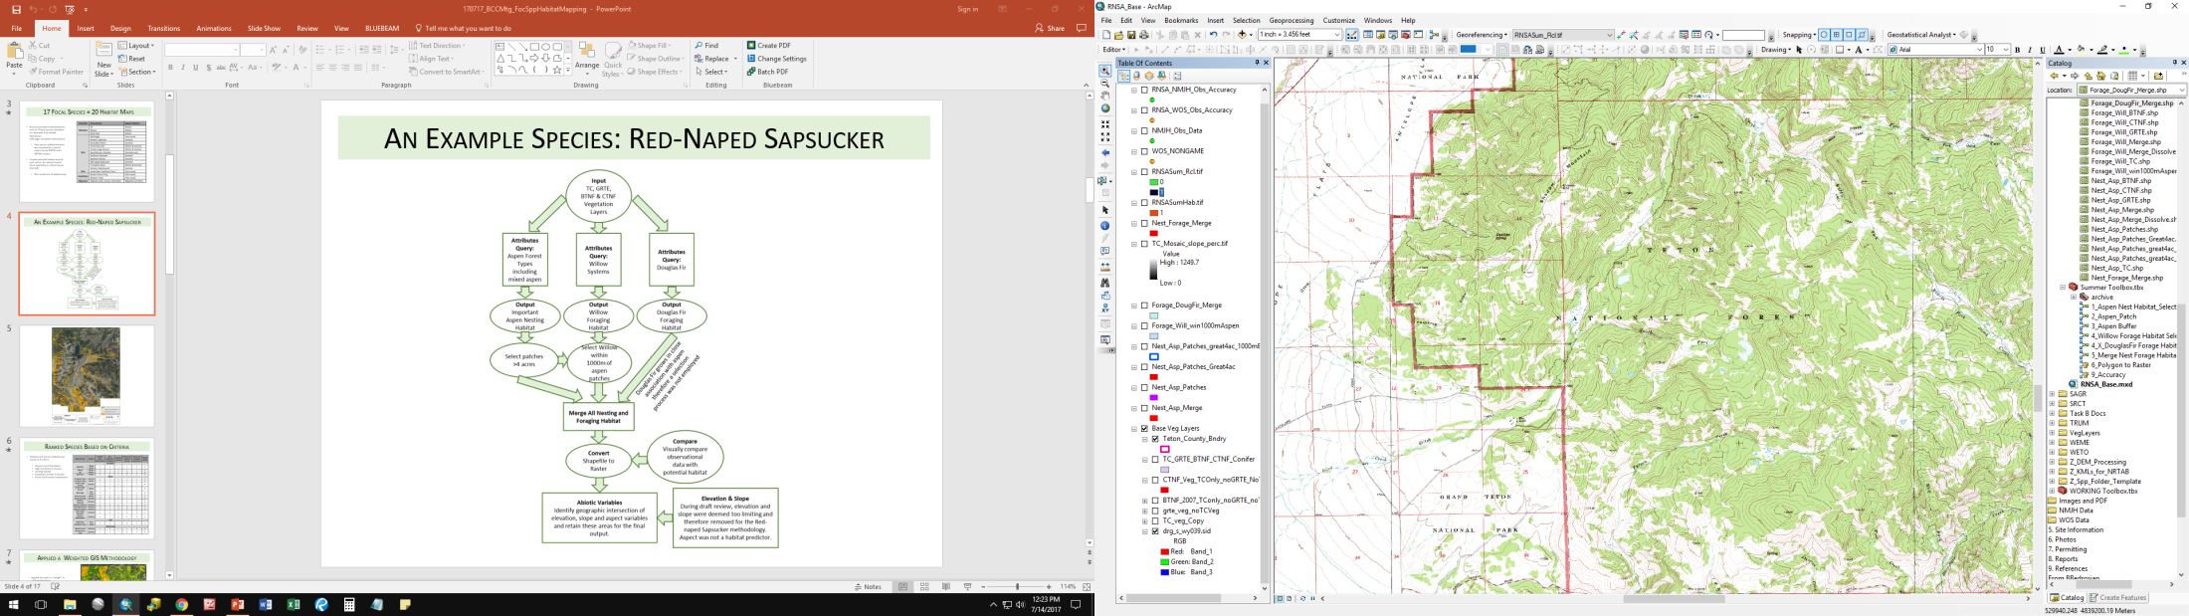
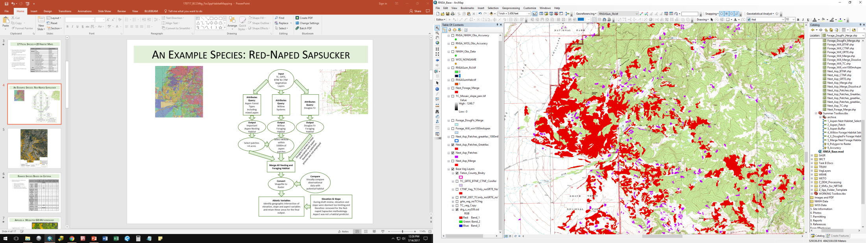
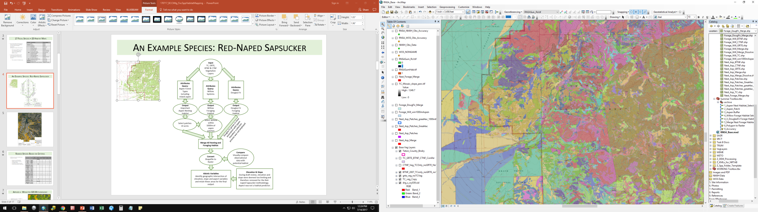
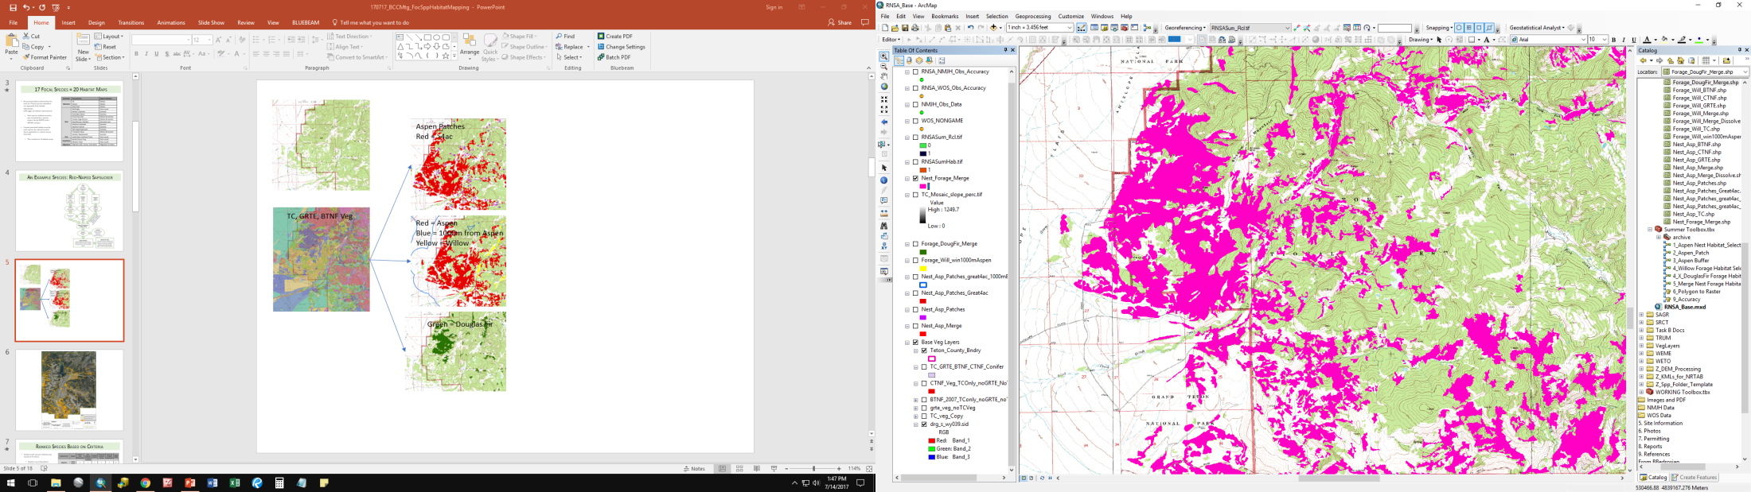
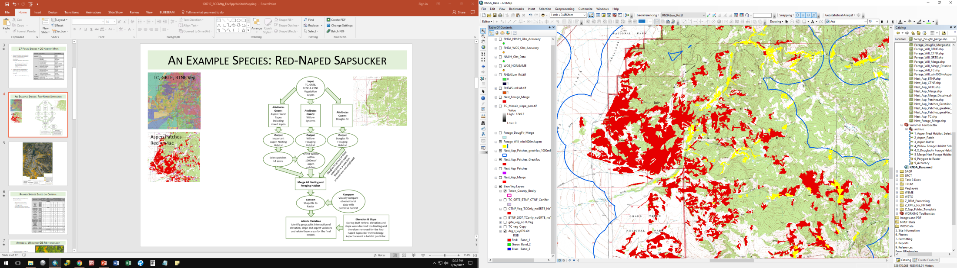
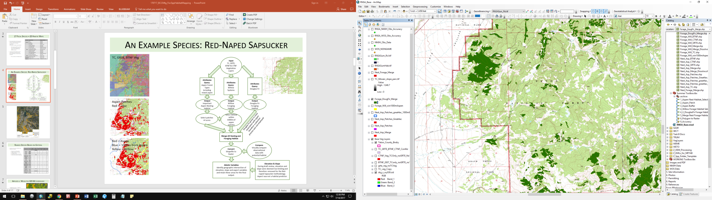
Example Species: Red-Naped Sapsucker
Aspen Patches
Red = >4ac
TC, GRTE, BTNF Veg
Red = Aspen
Blue = 1000m from Aspen
Yellow = Willow
Green = Douglas Fir

Slide 14
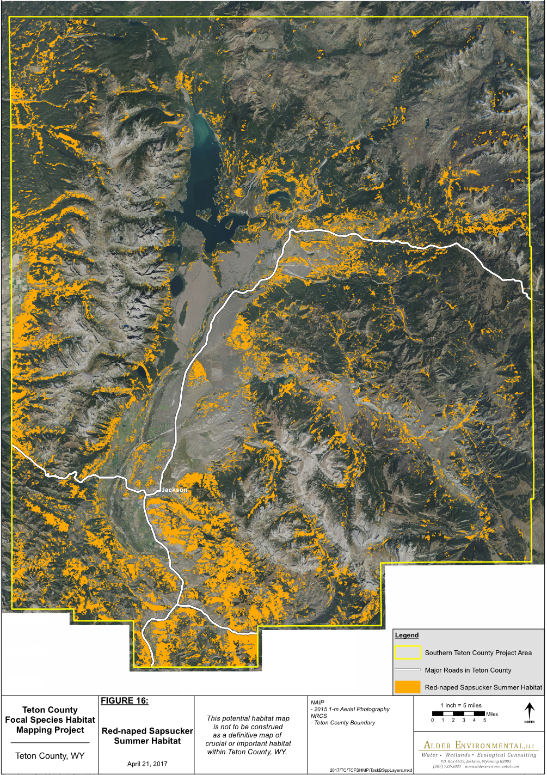
Example Species: Red-Naped Sapsucker

Slide 15
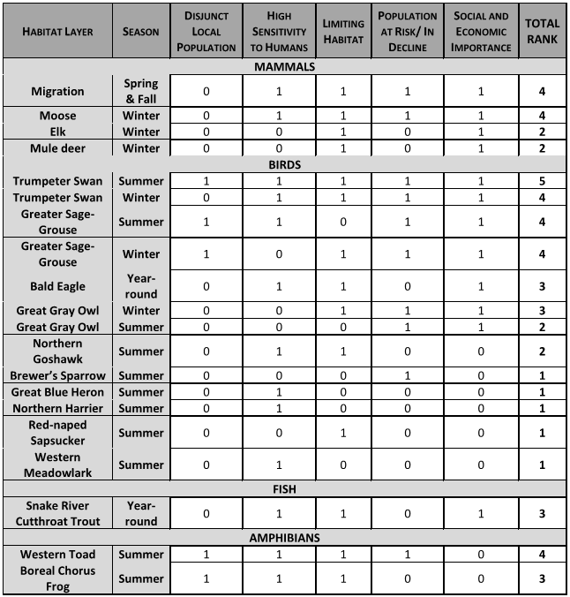
Professionals ranked each species habitat map based on 5 criteria:
Disjunct Local Population
High Sensitivity to Humans
Limiting Habitat
Population at Risk/ In Decline
Social and Economic Importance
Ranked Species Based on Criteria

Slide 16
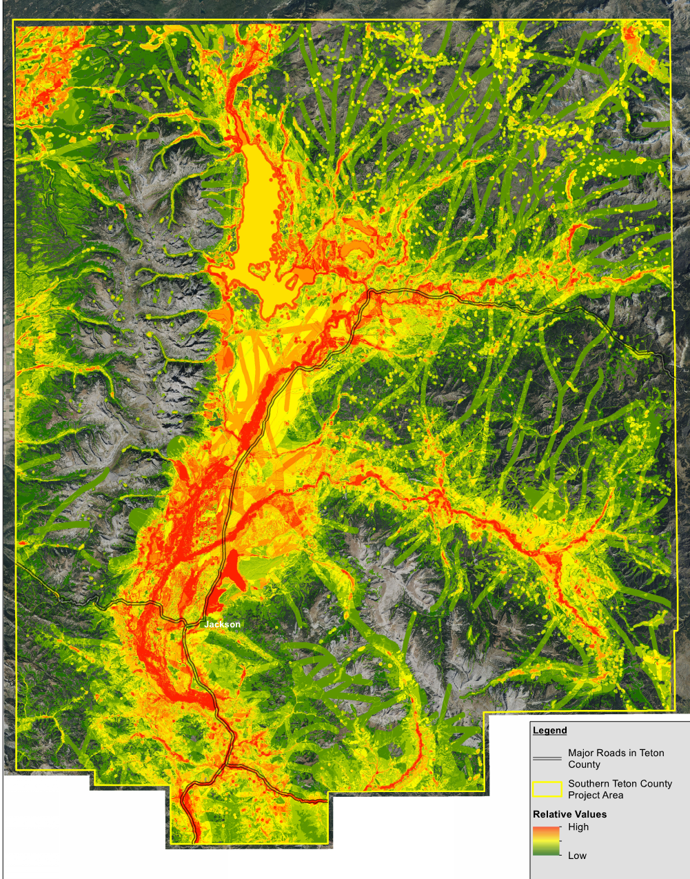
GIS Methodology
Applied the rank as a “weight” in a GIS methodology
Created Relative Values Habitat Map by adding all species habitat maps together.
Weighted Species Maps
1
Brewer’s Sparrow
2
Great Grey Owl – Summer
Red-naped Sapsucker
1
5
Trumpeter Swan– Summer
7
8
9
2
2
Relative Values Map

Slide 17
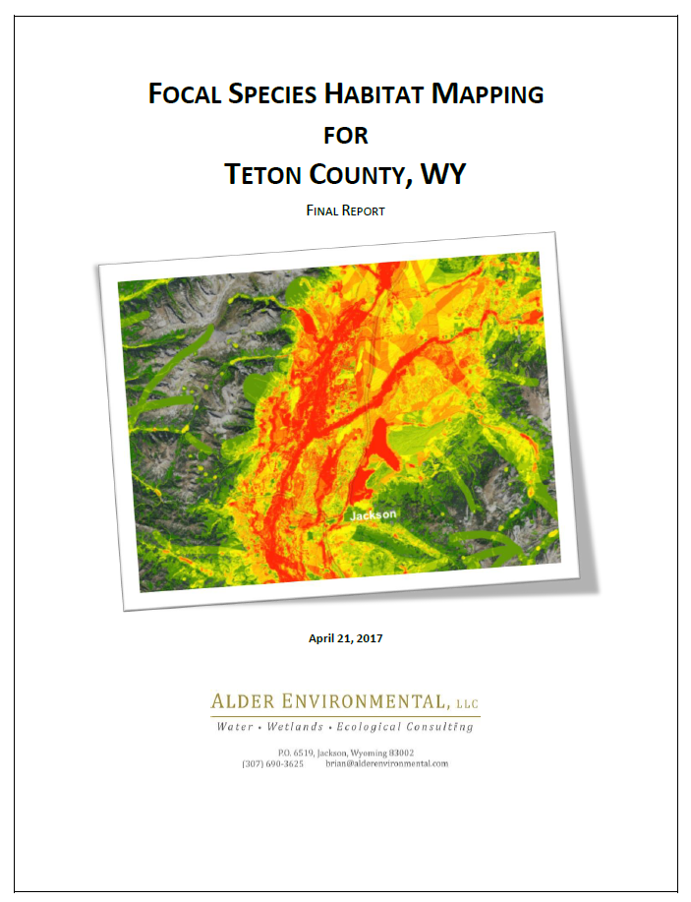

Slide 18
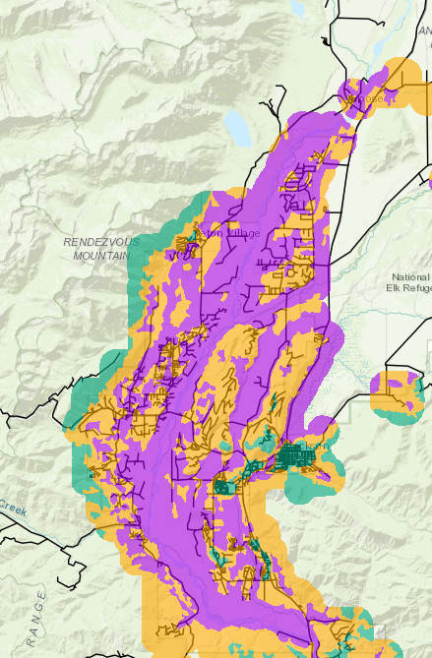
2023-2024
Tiers were created
Base – more development/ fewer habitat types or support fewer focal species
Mid – moderate number of habitat types, support more focal species, contain creeks if not within high tier
High – multiple habitat types, support multiple focal species, less development likely present
Draft LDR revised text
Correspond to Tiered NRO
Incorporate Permeability, Wildlife Movement and Migrations in text

Slide 19
Layout and Framework of Regulations
Presenter: Ryan Hostetter

Slide 20
Background
Tiered map drafted based on scientific approach
Use of map is at a landscape level – further review is site specific
Updated regulations drafted for future development within each tier
Base 5.2.1.F
Mid 5.2.1.G
High 5.2.1.H

Slide 21
Base Tier
Base Tier 5.2.1.F
Vegetation types with lower ordinal ranking or fewer types of natural resources
Process:
Desktop Checklist submitted with Application

Slide 22
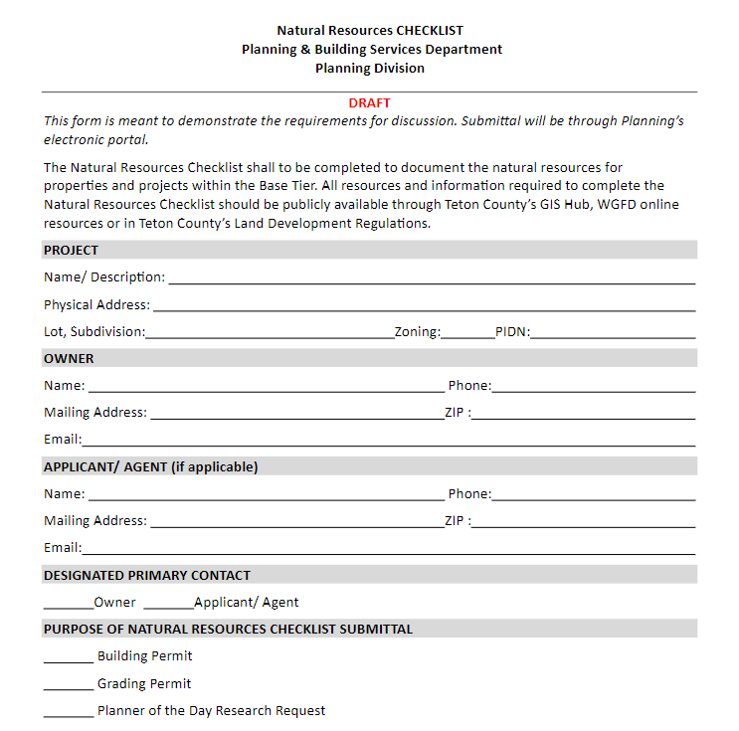
Base Tier
Desktop Checklist Includes:
Basic project information
Site questionnaire – what resources are present on and around the site
General site conditions
Description of critical findings
Can be elevated if necessary

Slide 23
Mid Tier
Mid Tier 5.2.1.G – “Environmental Review”
Pre Application Meeting required
Environmental Professional required
Similar to existing EA process without alternatives analysis
Apply for a “ZCV” (utilizes existing process)
Decision letter submitted to applicant detailing requirements
Alternatives analysis could be required if necessary – bump process to an EA
Appeal process existing per 8.8.3 if necessary

Slide 24
High Tier
High Tier 5.2.1.H
Similar process as existing 1994 NRO
Environmental Analysis required
Pre Application
Must hire environmental professional
Alternatives Analysis can be included
Planning Director Recommendation
Appeal process per 8.8.3 if necessary

Slide 25
EXAMPLES
Presenter: Megan Smith

Slide 26
Example Projects
All properties are 36 acres
All properties are hypothetical
An example for each Natural Resources Assessment Level
Base = Desktop Study Checklist
Mid = Environmental Review
High = Environmental Assessment
Ecological body of knowledge has three levels
Landscape – Tiered NRO
Population – WGFD Crucial Ranges and TC Suitable Habitat maps, Movement infrastructure and WGFD Designed Migration Corridors
Property – Natural Resources present on the property and vicinity
No one of these three levels can adequately inform a development decision. The entire body of knowledge is needed

Slide 27
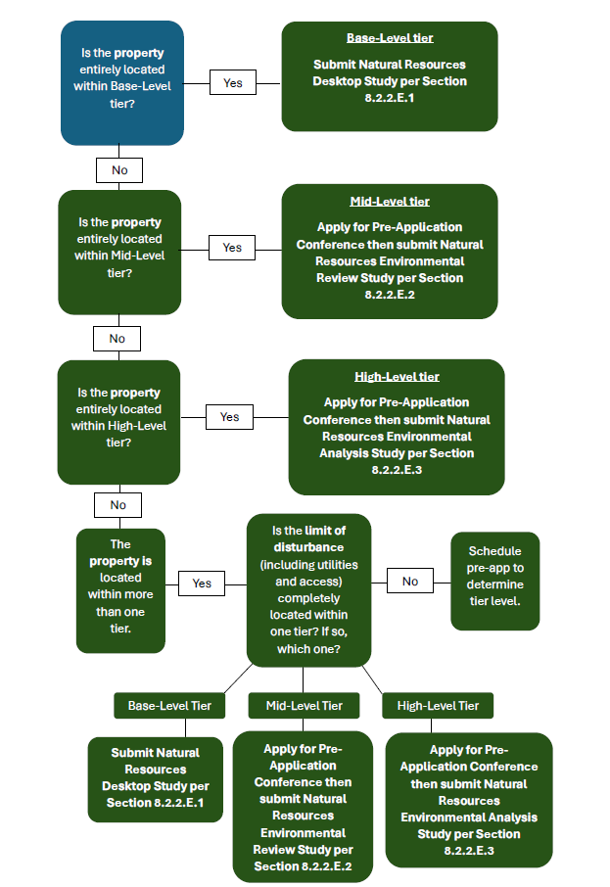
Process
How do we know where to start?
Page 54 of Packet in PDF

Slide 28
BASE TIER EXAMPLE
DESKTOP STUDY / CHECKLIST

Slide 29
Process

Slide 30
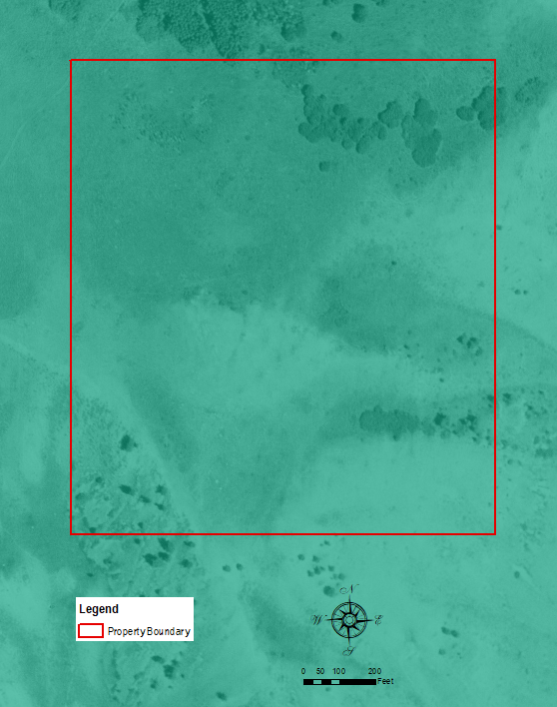
Property Location: Base Tier
Base Tier
CHECKLIST SUMMARY
NRO Tier
Waterbodies & Wetlands
Special Federal Species
Trumpeter Swan Nesting & Winter Habitat
Bald Eagle Nesting Habitat
Vegetative Cover Types
Fragmentation
WGFD Crucial Range and TC Focal Species Suitable Habitat
WGFD Designated Wildlife Corridors
Setbacks/ Buffers
Wildlife Friendly Fencing
Property Setbacks
Proposed Development

Slide 31
Natural Resources NOT Present
Base Tier
Landowner acknowledges through the checklist with any supporting materials that none of the following are present on the property:
Waterbodies & Wetlands
Special Federal Species
Trumpeter Swan Nesting & Winter Habitat
Bald Eagle Nesting Habitat
CHECKLIST SUMMARY
NRO Tier
Waterbodies & Wetlands
Special Federal Species
Trumpeter Swan Nesting & Winter Habitat
Bald Eagle Nesting Habitat
Vegetative Cover Types
Fragmentation
WGFD Crucial Range and TC Focal Species Suitable Habitat
WGFD Designated Wildlife Corridors
Setbacks/ Buffers
Wildlife Friendly Fencing
Property Setbacks
Proposed Development

Slide 32
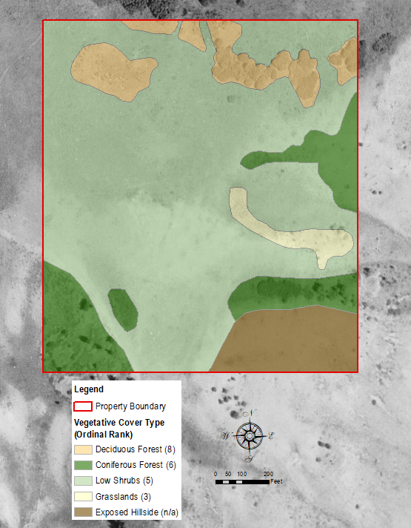
Vegetative Cover Types
Base Tier
CHECKLIST SUMMARY
NRO Tier
Waterbodies & Wetlands
Special Federal Species
Trumpeter Swan Nesting & Winter Habitat
Bald Eagle Nesting Habitat
Vegetative Cover Types
Fragmentation
WGFD Crucial Range and TC Focal Species Suitable Habitat
WGFD Designated Wildlife Corridors
Setbacks/ Buffers
Wildlife Friendly Fencing
Property Setbacks
Proposed Development

Slide 33
Base Tier
Vegetative Cover Ordinal Rank
LDR Section 5.2.1.D.5 – Intact Terrestrial Habitat Patches
Cover types have been updated from what is currently used for ease of use and transparency.
Higher ordinal rank typically indicate cover types that support more species and/ or are limited on the landscape or associated with water (a highly important resource).

Slide 34
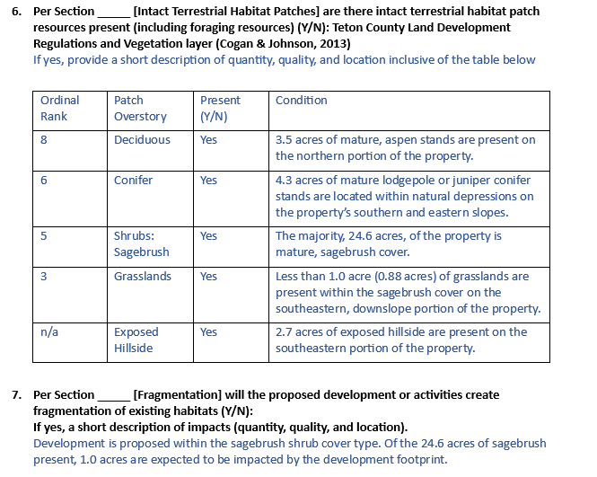
Base Tier
Vegetative Cover Types
From the Desktop Study:
CHECKLIST SUMMARY
NRO Tier
Waterbodies & Wetlands
Special Federal Species
Trumpeter Swan Nesting & Winter Habitat
Bald Eagle Nesting Habitat
Vegetative Cover Types
Fragmentation
WGFD Crucial Range and TC Focal Species Suitable Habitat
WGFD Designated Wildlife Corridors
Setbacks/ Buffers
Wildlife Friendly Fencing
Property Setbacks
Proposed Development

Slide 35
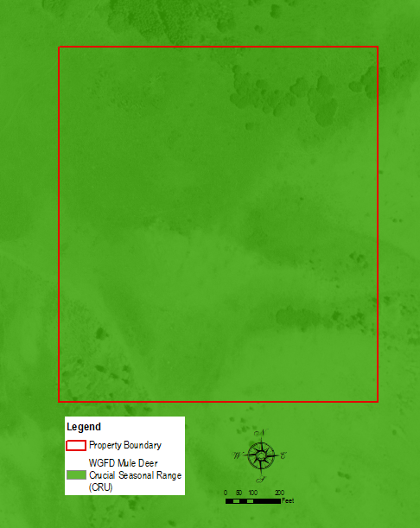
WGFD Designated Crucial Habitat
Base Tier
CHECKLIST SUMMARY
NRO Tier
Waterbodies & Wetlands
Special Federal Species
Trumpeter Swan Nesting & Winter Habitat
Bald Eagle Nesting Habitat
Vegetative Cover Types
Fragmentation
WGFD Crucial Range Further Refined by TC Focal Species Suitable Habitat
WGFD Designated Wildlife Corridors
Setbacks/ Buffers
Wildlife Friendly Fencing
Property Setbacks
Proposed Development
No WGFD Designated Wildlife Corridors are present on the property
WGFD Designated Mule Deer Crucial Winter Range
Present across the property
Put the landowner on notice but does not inform development decisions on the property

Slide 36
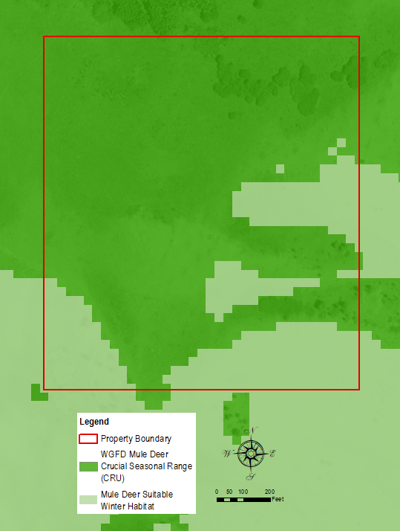
Crucial & Suitable Habitat
Base Tier
CHECKLIST SUMMARY
WGFD Crucial Range Further Refined by TC Focal Species Suitable Habitat
Elk & Moose – suitable winter habitat present but not designated crucial range
Overlaying Mule Deer Suitable Winter Habitat (darker green) on top of WGFD Designated Mule Deer Crucial Winter (lighter green)
Specifies where on the property suitable mule deer winter habitat resources likely are present
Informs the landowner’s development decisions on the property

Slide 37
Review Crucial & Suitable
Base Tier
To review:
Crucial Range – Areas Designated by WGFD as crucial to the species populations survival – primarily in winter. Not all resources within these designated areas are crucial to the specific species.
Suitable Habitat –Species specific layers identifying areas that likely contain resources for a specific species in winter. Layers created for each Focal Species and used in the creation of Teton County’s Tiered NRO.
Overlay - The refinement of crucial range with suitable habitat, identifies areas within the designated crucial range that provide the natural resources needed for species during the most crucial times of the year – typically winter and spring.

Slide 38
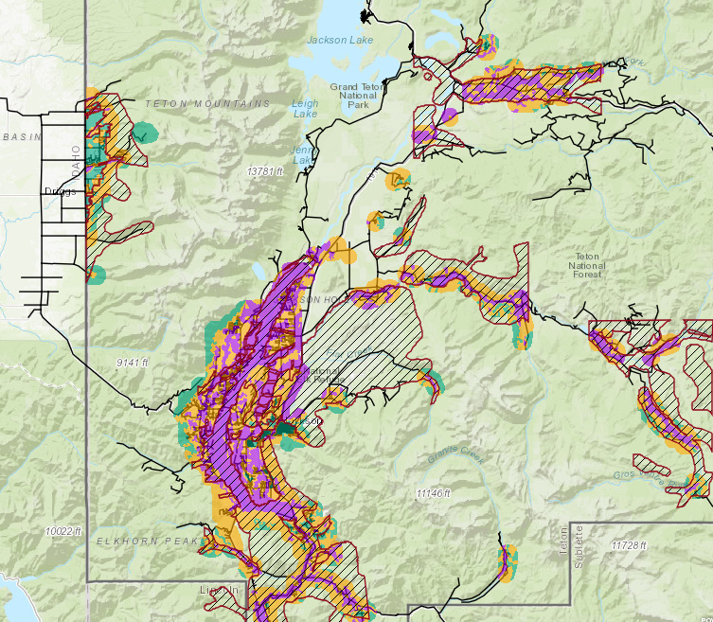
Review Crucial & Suitable
Landscape View
Base Tier

Slide 39
Natural Resources Setbacks and Fencing
Base Tier
CHECKLIST SUMMARY
NRO Tier
Waterbodies & Wetlands
Special Federal Species
Trumpeter Swan Nesting & Winter Habitat
Bald Eagle Nesting Habitat
Vegetative Cover Types
Fragmentation
WGFD Crucial Range and TC Focal Species Suitable Habitat
WGFD Designated Wildlife Corridors
Setbacks/ Buffers
Wildlife Friendly Fencing
Property Setbacks
Proposed Development
Landowner acknowledges through the checklist with any supporting materials that:
No Natural Resources requiring setbacks are present on the property.
No fencing is being proposed
An additional item:
Landowner added a note that there is a wildlife crossing located within ½ mile. No adjustments are needed because no fencing is proposed

Slide 40
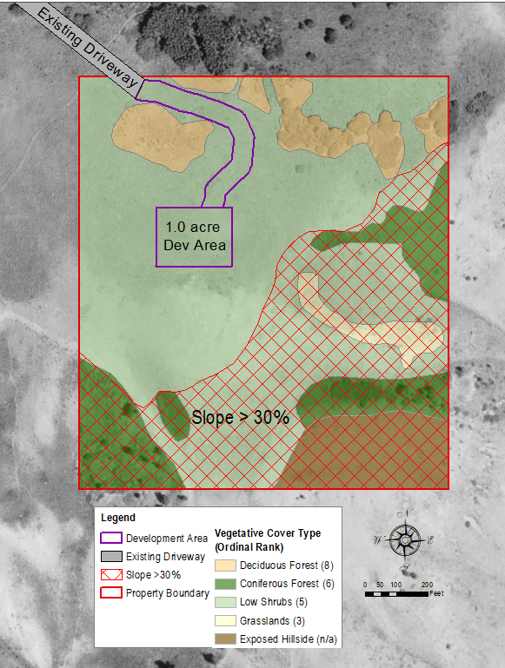
General Site Conditions
Base Tier
CHECKLIST SUMMARY
NRO Tier
Waterbodies & Wetlands
Special Federal Species
Trumpeter Swan Nesting & Winter Habitat
Bald Eagle Nesting Habitat
Vegetative Cover Types
Fragmentation
WGFD Crucial Range and TC Focal Species Suitable Habitat
WGFD Designated Wildlife Corridors
Setbacks/ Buffers
Wildlife Friendly Fencing
Property Setbacks
Proposed Development

Slide 41
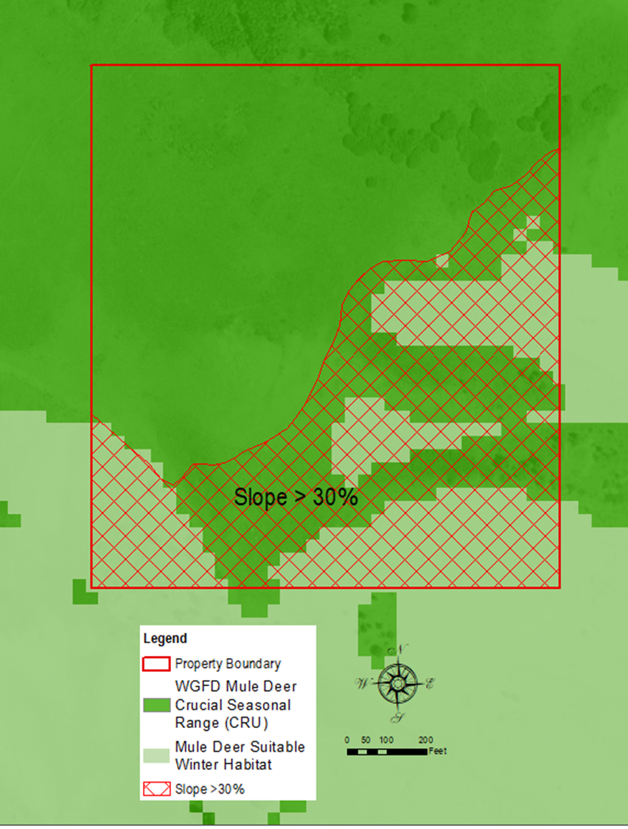
General Site Conditions
Base Tier
Slope and Mule Deer Suitable Habitat/ Crucial Range :
In this example, there is significant overlap between slope regulations and the areas on the property identified as mule deer suitable winter habitat
Both slope regulations and mule deer suitable habitats inform the location of development

Slide 42
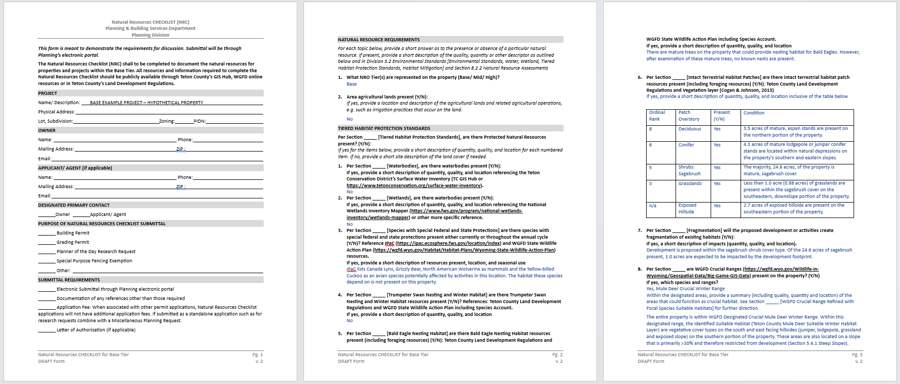
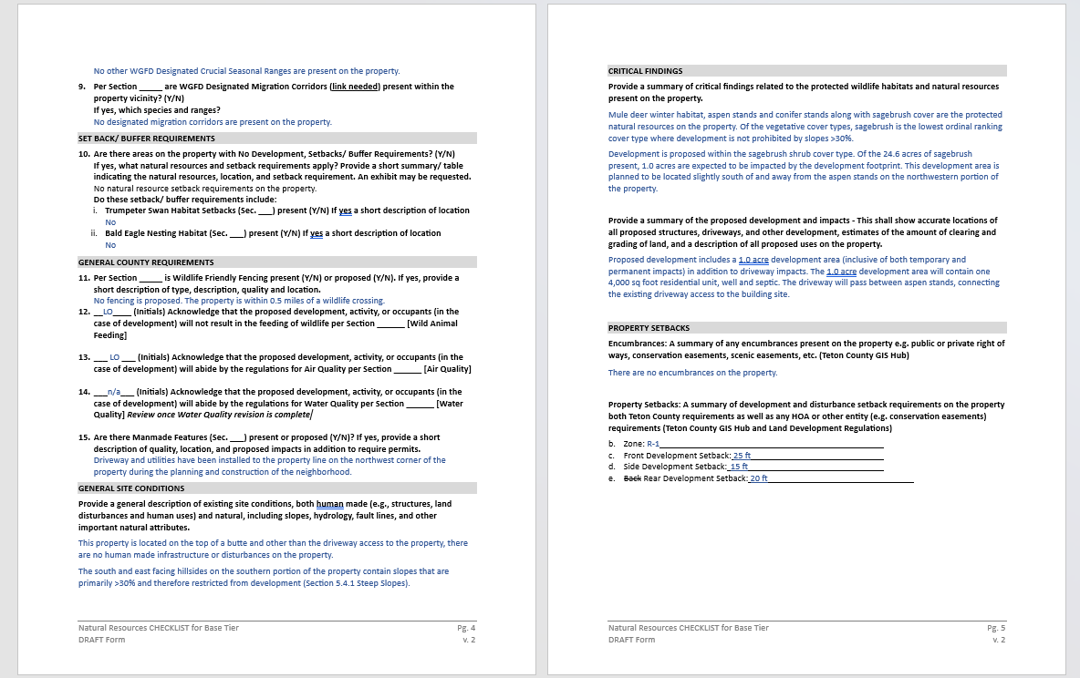
Desktop Checklist Documentation P. 55 of Packet
Base Tier

Slide 43
MID TIER EXAMPLE
ENVIRONMENTAL REVIEW DOCUMENTATION

Slide 44
Process

Slide 45
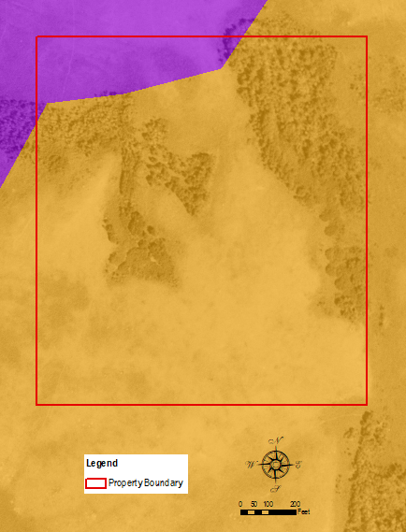
Property Location: Both Mid and High Tiers within property
Mid Tier
ENVIRONMENTAL REVIEW SUMMARY
NRO Tier
Waterbodies & Wetlands
Special Federal Species
Trumpeter Swan Nesting & Winter Habitat
Bald Eagle Nesting Habitat
Vegetative Cover Types
Fragmentation
WGFD Crucial Range and TC Focal Species Suitable Habitat
WGFD Designated Wildlife Corridors
Setbacks/ Buffers
Wildlife Friendly Fencing
Property Setbacks
Proposed Development

Slide 46
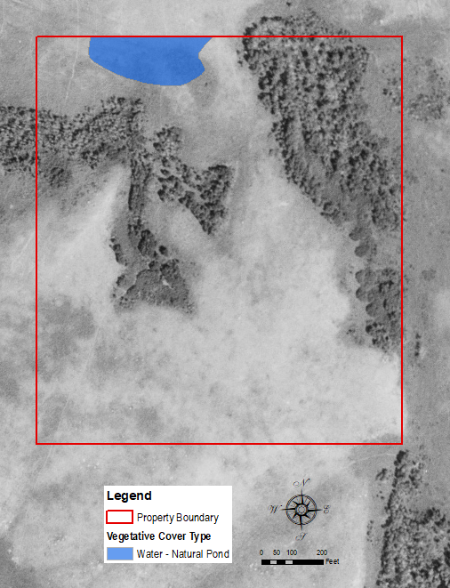
Natural Resources Present
Mid Tier
ENVIRONMENTAL REVIEW SUMMARY
NRO Tier
Waterbodies & Wetlands
Special Federal Species
Trumpeter Swan Nesting & Winter Habitat
Bald Eagle Nesting Habitat
Vegetative Cover Types
Fragmentation
WGFD Crucial Range and TC Focal Species Suitable Habitat
WGFD Designated Wildlife Corridors
Setbacks/ Buffers
Wildlife Friendly Fencing
Property Setbacks
Proposed Development

Slide 47
Natural Resources NOT Present
Mid Tier
ENVIRONMENTAL REVIEW SUMMARY
NRO Tier
Waterbodies & Wetlands
Special Federal Species
Trumpeter Swan Nesting & Winter Habitat
Bald Eagle Nesting Habitat
Vegetative Cover Types
Fragmentation
WGFD Crucial Range and TC Focal Species Suitable Habitat
WGFD Designated Wildlife Corridors
Setbacks/ Buffers
Wildlife Friendly Fencing
Property Setbacks
Proposed Development
Consultant acknowledges through Environmental Review, with supporting materials, that none of the following are present on the property:
Special Federal Species
Trumpeter Swan Nesting & Winter Habitat
Bald Eagle Nesting Habitat

Slide 48
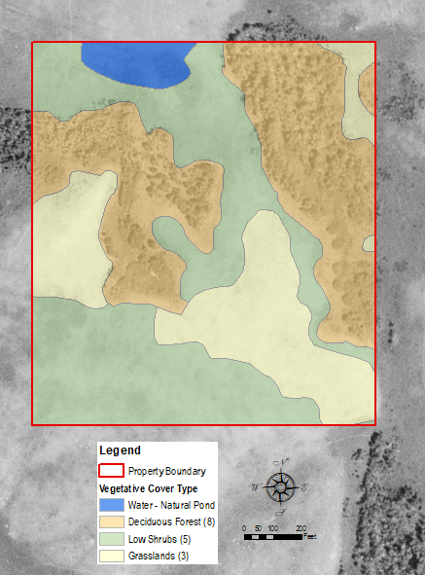
Vegetative Cover Types
Mid Tier
ENVIRONMENTAL REVIEW SUMMARY
NRO Tier
Waterbodies & Wetlands
Special Federal Species
Trumpeter Swan Nesting & Winter Habitat
Bald Eagle Nesting Habitat
Vegetative Cover Types
Fragmentation
WGFD Crucial Range and TC Focal Species Suitable Habitat
WGFD Designated Wildlife Corridors
Setbacks/ Buffers
Wildlife Friendly Fencing
Property Setbacks
Proposed Development

Slide 49
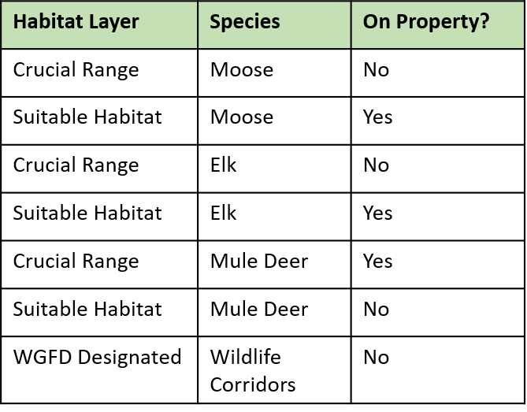
Crucial & Suitable Habitat
Mid Tier
ENVIRONMENTAL REVIEW SUMMARY
NRO Tier
Waterbodies & Wetlands
Special Federal Species
Trumpeter Swan Nesting & Winter Habitat
Bald Eagle Nesting Habitat
Vegetative Cover Types
Fragmentation
WGFD Crucial Range and TC Focal Species Suitable Habitat
WGFD Designated Wildlife Corridors
Setbacks/ Buffers
Wildlife Friendly Fencing
Property Setbacks
Proposed Development
ER would include maps and table displaying this information
Moose – Possibility of aspen use in transitional times but unlikely in winter
Elk - Possibility of grasses use in transitional times but unlikely in winter
Mule Deer – While Crucial Range is designed, suitable habitat is not present therefore, may move through but unlikely to be present at most crucial times
Wildlife Movement – No designated corridors present.
Wildlife movement likely, wildlife natural resources needed during crucial times not likely

Slide 50
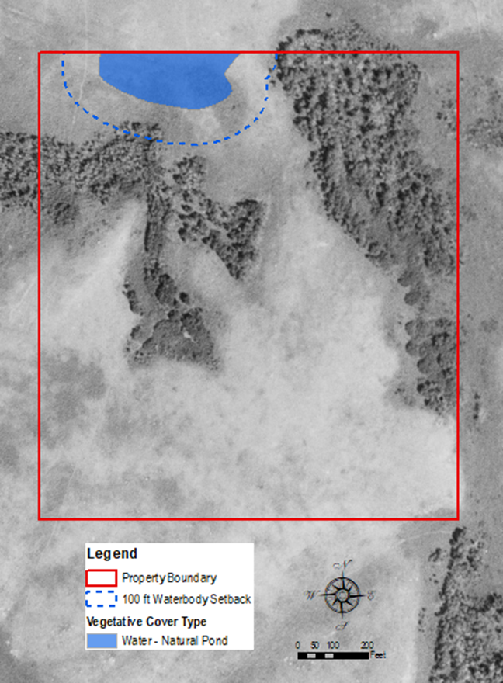
Natural Resources Setbacks and Fencing
Mid Tier
ENVIRONMENTAL REVIEW SUMMARY
NRO Tier
Waterbodies & Wetlands
Special Federal Species
Trumpeter Swan Nesting & Winter Habitat
Bald Eagle Nesting Habitat
Vegetative Cover Types
Fragmentation
WGFD Crucial Range and TC Focal Species Suitable Habitat
WGFD Designated Wildlife Corridors
Setbacks/ Buffers
Wildlife Friendly Fencing
Property Setbacks
Proposed Development
Natural Resource Setbacks – 100 ft Pond
No Fencing proposed

Slide 51
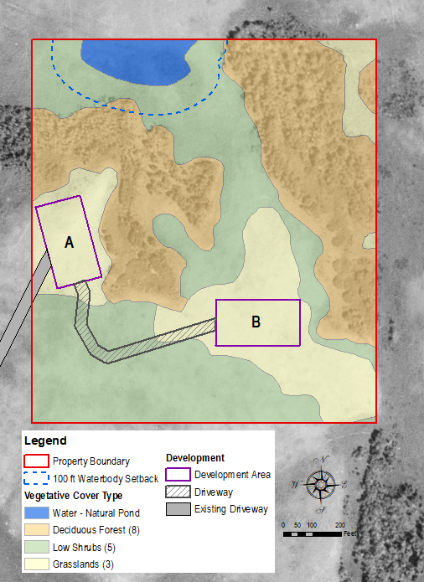
General Site Conditions
Mid Tier
ENVIRONMENTAL REVIEW SUMMARY
NRO Tier
Waterbodies & Wetlands
Special Federal Species
Trumpeter Swan Nesting & Winter Habitat
Bald Eagle Nesting Habitat
Vegetative Cover Types
Fragmentation
WGFD Crucial Range and TC Focal Species Suitable Habitat
WGFD Designated Wildlife Corridors
Setbacks/ Buffers
Wildlife Friendly Fencing
Property Setbacks
Proposed Development

Slide 52
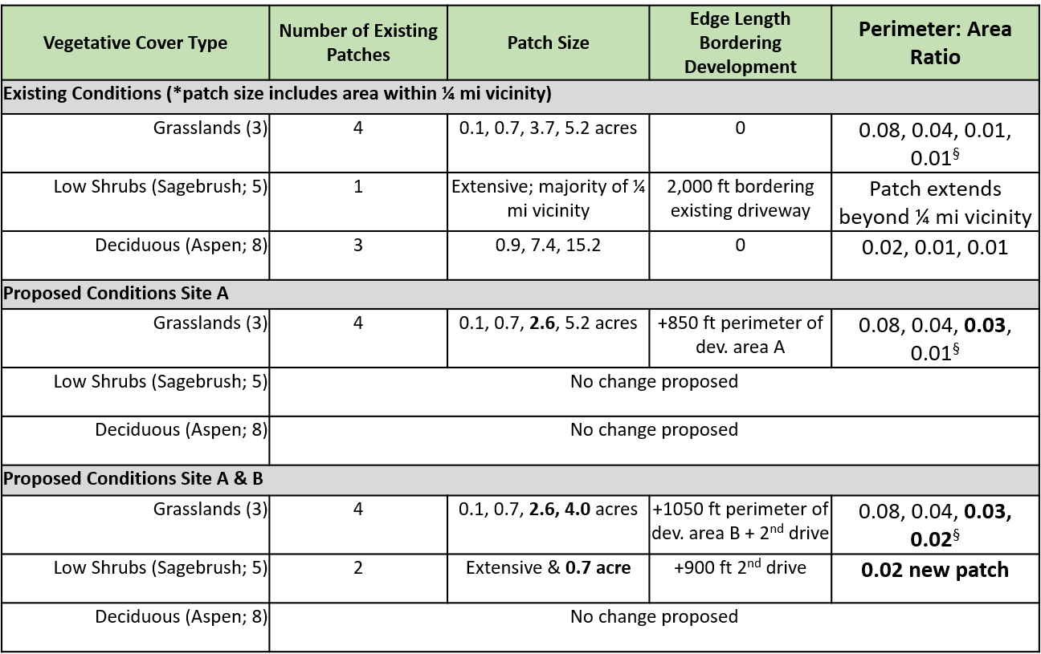
Fragmentation
Mid Tier
§ larger P/A indicate more edge and less interior habitat

Slide 53
Process
Proposing only development Area A provides a clear path to an ER
Proposing Area A and Area B areas combined: Depends on specifics and may be resolved by a discussion at the Pre-App Conference displaying avoidance and minimization

Slide 54
Process
Desire to display alternatives or disagreement with the Planning Director decision: The applicant may request to do an EA with Alternatives Analysis to display proposal and efforts to minimize impacts

Slide 55
HIGH TIER EXAMPLE #1
ENVIRONMENTAL ASSESSMENT
DOCUMENTATION

Slide 56
Process

Slide 57
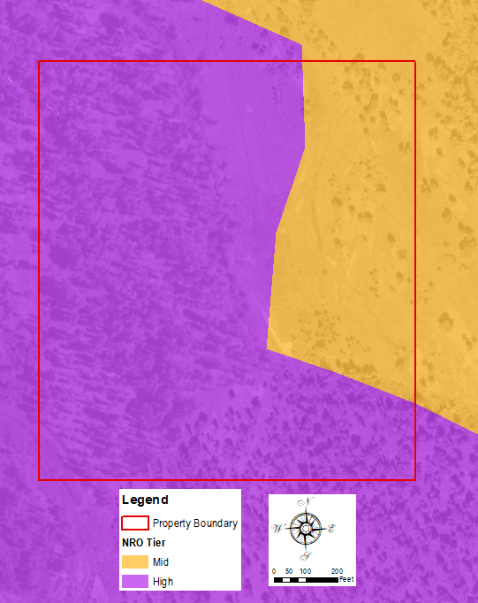
Property Location: Mid & High Tier
High Tier
ENVIRONMENTAL ASSESSMENT SUMMARY
NRO Tier
Waterbodies & Wetlands
Special Federal Species
Trumpeter Swan Nesting & Winter Habitat
Bald Eagle Nesting Habitat
Vegetative Cover Types
Fragmentation
WGFD Crucial Range and TC Focal Species Suitable Habitat
WGFD Designated Wildlife Corridors
Setbacks/ Buffers
Wildlife Friendly Fencing
Property Setbacks
Proposed Development

Slide 58
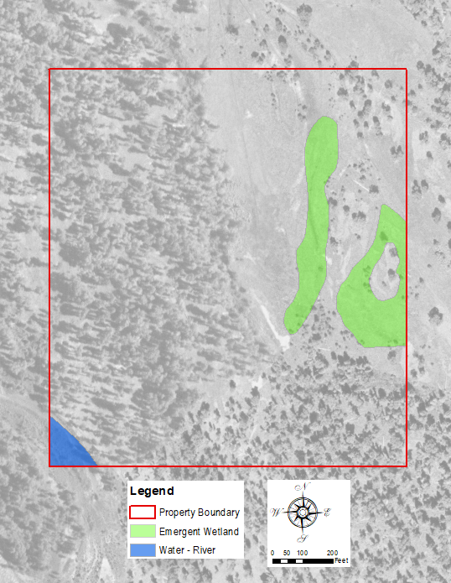
Natural Resources Present
High Tier
ENVIRONMENTAL ASSESSMENT SUMMARY
NRO Tier
Waterbodies & Wetlands
Special Federal Species
Trumpeter Swan Nesting & Winter Habitat
Bald Eagle Nesting Habitat
Vegetative Cover Types
Fragmentation
WGFD Crucial Range and TC Focal Species Suitable Habitat
WGFD Designated Wildlife Corridors
Setbacks/ Buffers
Wildlife Friendly Fencing
Property Setbacks
Proposed Development

Slide 59
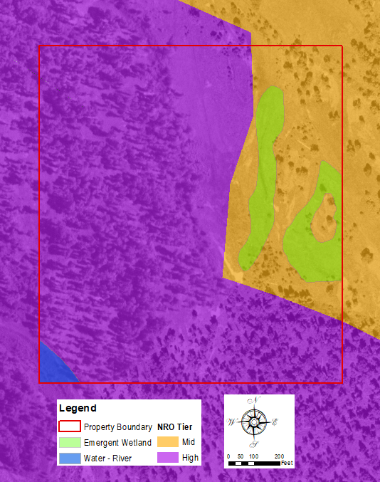
Vegetative Cover
High Tier
ENVIRONMENTAL ASSESSMENT SUMMARY
NRO Tier
Waterbodies & Wetlands
Special Federal Species
Trumpeter Swan Nesting & Winter Habitat
Bald Eagle Nesting Habitat
Vegetative Cover Types
Fragmentation
WGFD Crucial Range and TC Focal Species Suitable Habitat
WGFD Designated Wildlife Corridors
Setbacks/ Buffers
Wildlife Friendly Fencing
Property Setbacks
Proposed Development

Slide 60
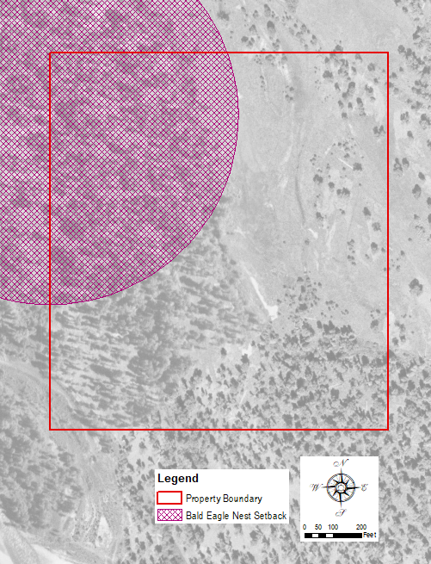
Natural Resources Present
High Tier
CHECKLIST SUMMARY
NRO Tier
Waterbodies & Wetlands
Special Federal Species
Trumpeter Swan Nesting & Winter Habitat
Bald Eagle Nesting Habitat
Vegetative Cover Types
Fragmentation
WGFD Crucial Range and TC Focal Species Suitable Habitat
WGFD Designated Wildlife Corridors
Setbacks/ Buffers
Wildlife Friendly Fencing
Property Setbacks
Proposed Development
Special Federal Species
Trumpeter Swan Nesting & Winter Habitat

Slide 61
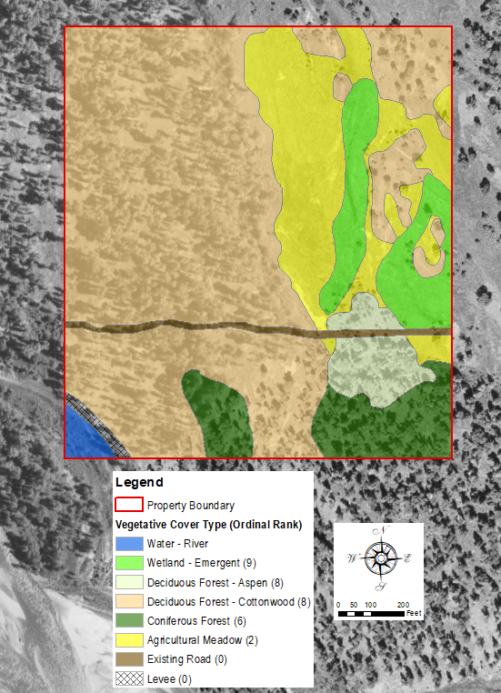
Vegetative Cover Types
High Tier
CHECKLIST SUMMARY
NRO Tier
Waterbodies & Wetlands
Special Federal Species
Trumpeter Swan Nesting & Winter Habitat
Bald Eagle Nesting Habitat
Vegetative Cover Types
Fragmentation
WGFD Crucial Range and TC Focal Species Suitable Habitat
WGFD Designated Wildlife Corridors
Setbacks/ Buffers
Wildlife Friendly Fencing
Property Setbacks
Proposed Development

Slide 62
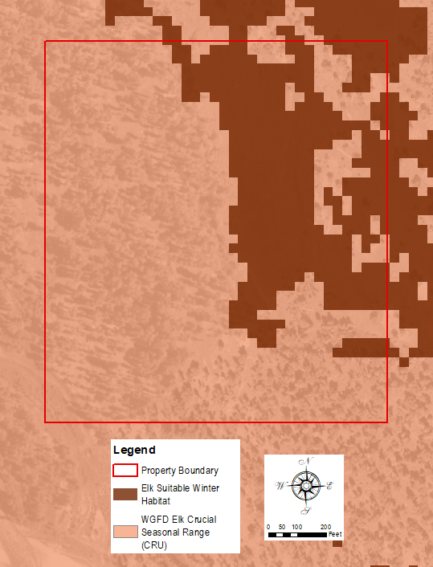
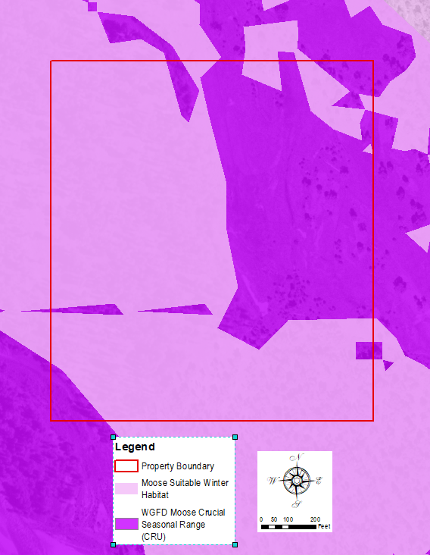
Crucial & Suitable Habitat
High Tier
No WGFD Designated Wildlife Corridors or Mule Deer Crucial Seasonal Range present on the property

Slide 63
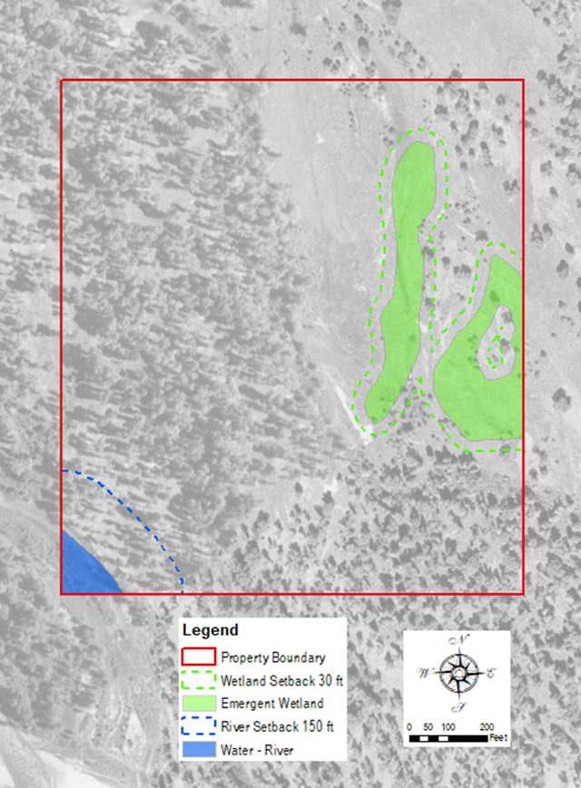
Natural Resources Setbacks and Fencing
High Tier
CHECKLIST SUMMARY
NRO Tier
Waterbodies & Wetlands
Special Federal Species
Trumpeter Swan Nesting & Winter Habitat
Bald Eagle Nesting Habitat
Vegetative Cover Types
Fragmentation
WGFD Crucial Range and TC Focal Species Suitable Habitat
WGFD Designated Wildlife Corridors
Setbacks/ Buffers
Wildlife Friendly Fencing
Property Setbacks
Proposed Development

Slide 64
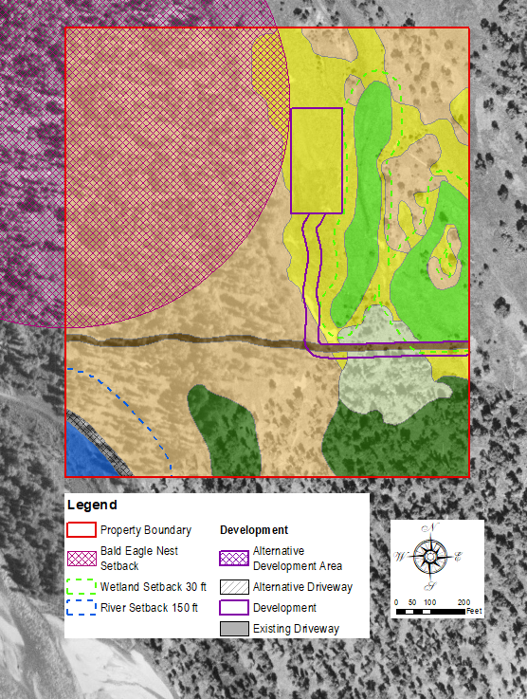
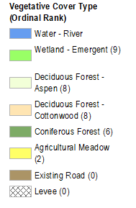
General Site Conditions & Setbacks
High Tier
CHECKLIST SUMMARY
NRO Tier
Waterbodies & Wetlands
Special Federal Species
Trumpeter Swan Nesting & Winter Habitat
Bald Eagle Nesting Habitat
Vegetative Cover Types
Fragmentation
WGFD Crucial Range and TC Focal Species Suitable Habitat
WGFD Designated Wildlife Corridors
Setbacks/ Buffers
Wildlife Friendly Fencing
Property Setbacks
Proposed Development

Slide 65
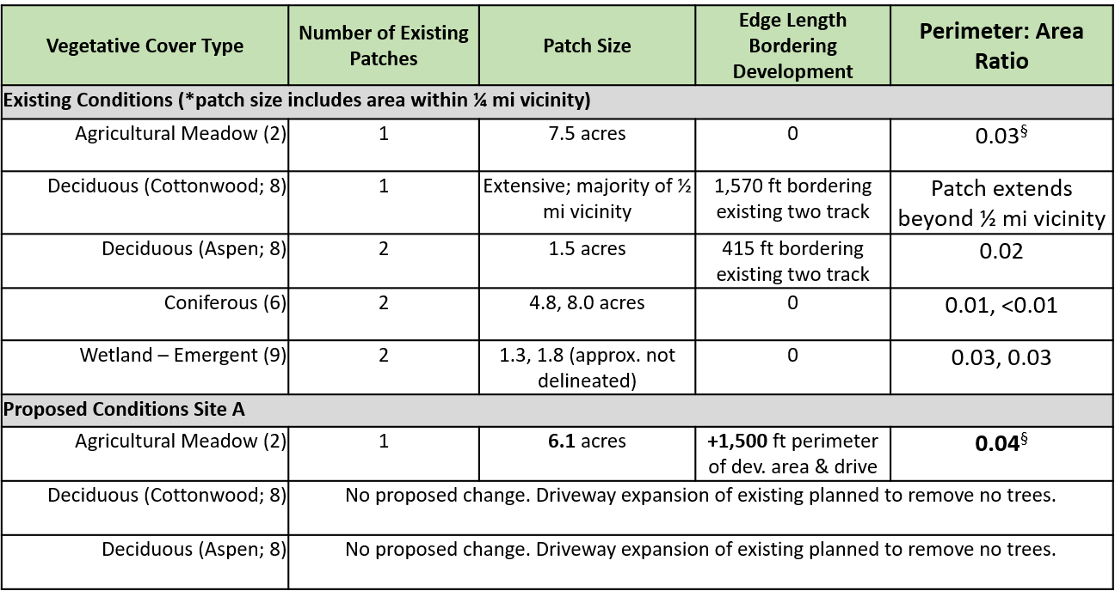
Fragmentation
High Tier
§ larger P/A indicate more edge and less interior habitat

Slide 66
HIGH TIER EXAMPLE # 2
ENVIRONMENTAL ASSESSMENT
DOCUMENTATION

Slide 67
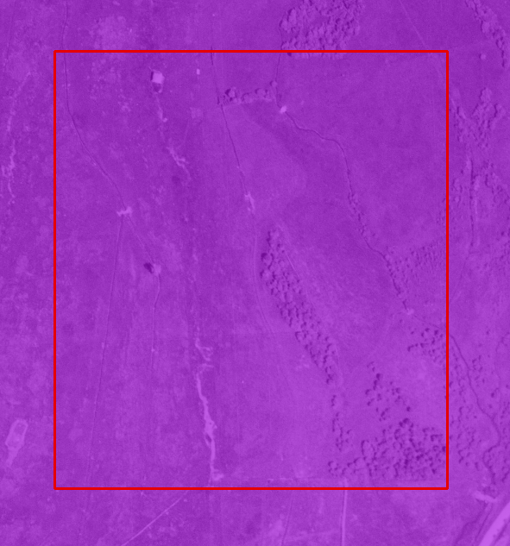
Property Location: High Tier
High Tier
ENVIRONMENTAL ASSESSMENT SUMMARY
NRO Tier
Waterbodies & Wetlands
Special Federal Species
Trumpeter Swan Nesting & Winter Habitat
Bald Eagle Nesting Habitat
Vegetative Cover Types
Fragmentation
WGFD Crucial Range and TC Focal Species Suitable Habitat
WGFD Designated Wildlife Corridors
Setbacks/ Buffers
Wildlife Friendly Fencing
Property Setbacks
Proposed Development
Notes:
Reminder: Property remains in agricultural production are exempt;
This example is if a currently agricultural area is being developed such as for a residence

Slide 68

Vegetative Cover Types
High Tier
CHECKLIST SUMMARY
NRO Tier
Waterbodies & Wetlands
Special Federal Species
Trumpeter Swan Nesting & Winter Habitat
Bald Eagle Nesting Habitat
Vegetative Cover Types
Fragmentation
WGFD Crucial Range and TC Focal Species Suitable Habitat
WGFD Designated Wildlife Corridors
Setbacks/ Buffers
Wildlife Friendly Fencing
Property Setbacks
Proposed Development
Willow or other shrub component

Slide 69

Natural Resources Present
High Tier
CHECKLIST SUMMARY
NRO Tier
Waterbodies & Wetlands
Special Federal Species
Trumpeter Swan Nesting & Winter Habitat
Bald Eagle Nesting Habitat
Vegetative Cover Types
Fragmentation
WGFD Crucial Range and TC Focal Species Suitable Habitat
WGFD Designated Wildlife Corridors
Setbacks/ Buffers
Wildlife Friendly Fencing
Property Setbacks
Proposed Development
Visual Check For Sign of Swans & Eagles
Notes:
Creeks vs irrigation ditches
Many areas of willow that have been impacted by agricultural operations will recover if remnants are present, water source is natural and browse pressures are lessened

Slide 70

Crucial & Suitable Habitat
High Tier
Species Layer | On Property | In Vicinity
Mule Deer Crucial | Yes | Yes
Mule Deer Suitable | Yes (shrubs) | Yes (aspen)
Elk Crucial | No | No
Elk Suitable | Yes | Yes
Moose Crucial | No | No
Moose Suitable | Yes (shrubs) | Yes

Slide 71
Wildlife Movement
High Tier
Wildlife crossing w/in ½ mi of the property
Property converting from agricultural operation to residential development – prioritize wildlife friendly fencing regulations
Movement corridor showing East/ West direction of travel
Prioritize development design that is clustered and prioritizes unhindered east/ west direction of travel with line of sight and ample space from development

Slide 72

Fragmentation
High Tier
Suggestions:
Centralize development
neighbor’s development
Avoid shrub cover
Leave southern portion, including shrub cover, open to wildlife movement
Cluster building locations
Goal: maintain intact habitat, lessen edge, buffer waterways

Slide 73
Existing NRO vs Proposed Tiers
What are the primary differences between the current 1994 NRO and the proposed tiered system?
Presenter: Ryan Hostetter

Slide 74

Existing NRO vs Proposed Tiers

Slide 75

Existing NRO vs Proposed Tiers

Slide 76

Existing NRO vs Proposed Tiers

Slide 77

Existing NRO vs Proposed Tiers

Slide 78
Waterbody & Wetland Setbacks
Sec. 5.1.1. Waterbody and Wetland Setbacks

Slide 79
Waterbody & Wetland Setbacks
2018 Draft received stakeholder input
Some edits proposed, although not a full overhaul
River and Wetland setback buffer distance unchanged in draft
Streams:
Revised for consistency & predictability – change to 100 feet
Ephemeral – change to 30 feet (matching wetland)
Natural Lake/Pond – change to 100 feet
Additional Edits included:
Added definitions for clarity
Removal of 3 cfs requirement for stream

Slide 80

Waterbody & Wetland Setbacks

Slide 81
Waterbody & Wetland Setbacks
Options:
Staff Recommendation – move forward with these edits & continue to refine and further amend through Water Quality LDR amendment process (coming in the next couple years)
May include other minor edits now as recommended
Additional Option - Wait on 5.1.1. altogether (not recommended by staff)
Development will continue with 50 foot setbacks (rather than 100)
Outcome for stream and lake/pond setbacks unknown
Revisit work completed in 2018 draft with stakeholders

Slide 82
Planning Commission
Completed review on October 28, 2024
Greenline draft shows PC Edits dated October 22, 2024 and recommended for approval on October 28, 2024
Added migration and wildlife crossing information
Updated ordinal ranking for wetlands
Several small edits and type-o’s
Recommended Approval

Slide 83
Questions?
Public Comment – continuing to be received
Additional Direction
Next meeting date?

Slide 87
Prop Numbers
Calculations used property centroid
State and Federal properties excluded – 14,122 parcels
2,217 parcels with centroid in 1994 NRO
2,911 parcels with centroid in High Tier
9,704 parcels with centroid in Mid and/or High Tier
Conservation Easements
208 of 395 CEs have their centroid within the High Tier
370 of 395 CEs have their centroid within the Mid and/or High Tier

