Slide 1
Natural Resource Overlay Amendment AMD2024-0004 & ZMA2024-0001 -CONTINUED HEARING - October 28, 2024 Presenters: Ryan Hostetter & Megan Smith, EcoConnect Consulting LLC
Jackson & Teton County Long Range Planning

Slide 2
Presentation Contents
Continued meeting from October 14, 2024
Questions provided from October 14th to be addressed
How did we arrive at the Tiers (Megan Smith, EcoConnect)
Permeability and Migration
Waterbody and Wetland Setbacks
Plan Review Committee Process (PRC)
Public Lands
Additional Questions
Public Comment
Recommendation

Slide 3
CURRENT PROCESS
Background
Div 5.1 applies to all properties in Teton County
Waterbodies & Wetlands
Div 5. Applies to Properties
in the NRO
In the NRO?
YES
NO
Complete
Environmental Analysis (EA)
inclusive of
Topics from Div 5.1 & 5.2
If Applicable:
Wetland Delineation (Aquatic Resources Inventory)
Alternatives Analysis
Complete
Zoning Compliance Verification (ZCV) for Environmental Standards
inclusive of
Water, wetlands, Trumpeter Swans, Trout, Bald Eagles

Slide 4
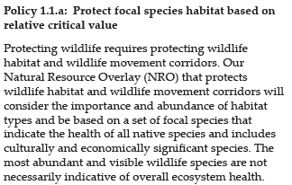
Background
2012 - Comp Plan Directive 1.1.a
1994 NRO and Tiered NRO are a LANDSCAPE level tools.
Tool determines process
Honor Ecosystem Stewardship Commitment

Slide 5
Prior to 2016
Focal Species selected by Natural Resources Technical Advisory Board (NRTAB) and TC Planning
2016
Focal Species List was refined to represent habitat types across Teton County
2016-2017
Focal Species Habitat Layers and Relative Values Habitat Map were produced – the basis of the Tiered NRO
Background

Slide 6
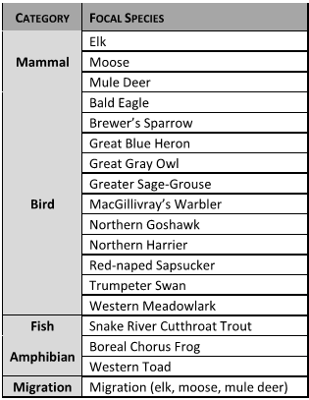
2016-2017 Process
Expert Participants
Natural Resources Technical Advisory Board (NRTAB)
WGFD Biologists
TC Planning Staff
Team including local researchers/ species experts

Slide 7
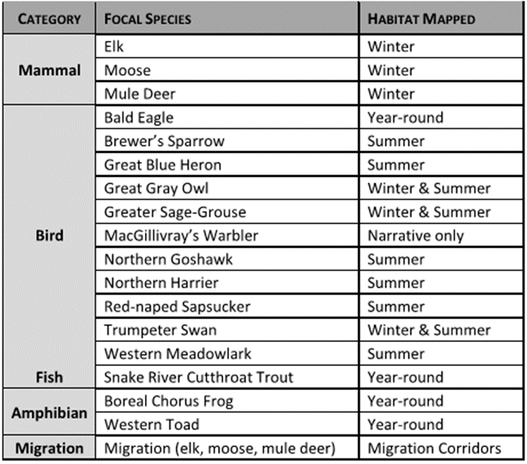
Focal Species
Species habitat narratives
written by specialist,
reviewed by experts and NRTAB
Created 20 Suitable Habitat Layers by Species

Slide 8
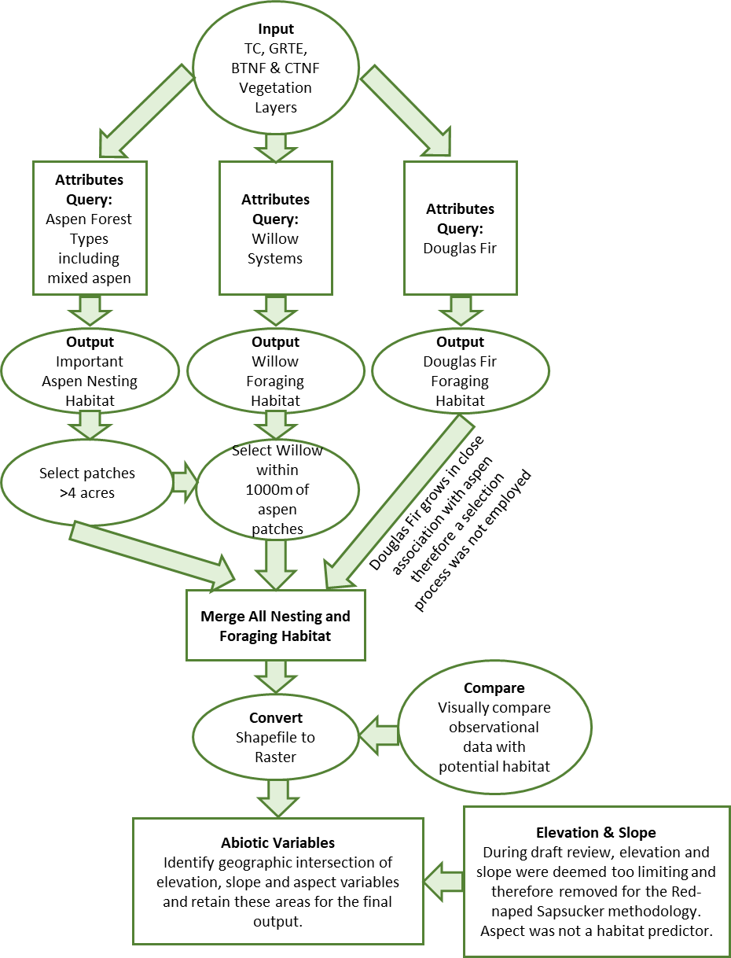
Habitat Characteristic | Selection Criteria
Aspen vegetative cover and mixed forest containing aspen component | Patch size >1.7 ha (4 ac); If available the number of trees >18 cm DBH (approx. 7 inches) would reflect a measure of available nest trees
Slope | 8.0 – 34.0% (17% average)
Elevation | Valley floor to approximately 9,000 ft. In GRTE, aspen phases out at ~9,500 ft. In Grand Junction CO elevations were 2,459-3,291m (8,000 – 10,800 ft).
Distance from aspen to riparian willow areas | 250 m (~800 ft)
Association with foraging vegetation (Douglas Fir and willow areas) within 16 ha (40 ac – approx. home range) | Percent aspen in a territory is positively correlated with nest productivity and available nest sites. Therefore, higher percentages of aspen could be an indicator of higher value habitat
Example Species: Red-Naped Sapsucker

Slide 9
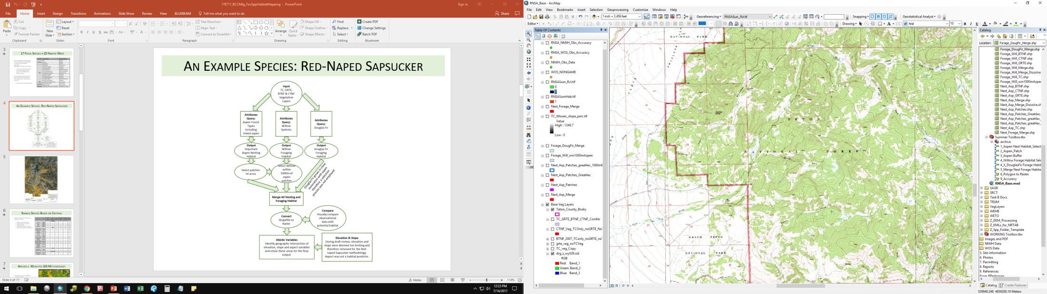
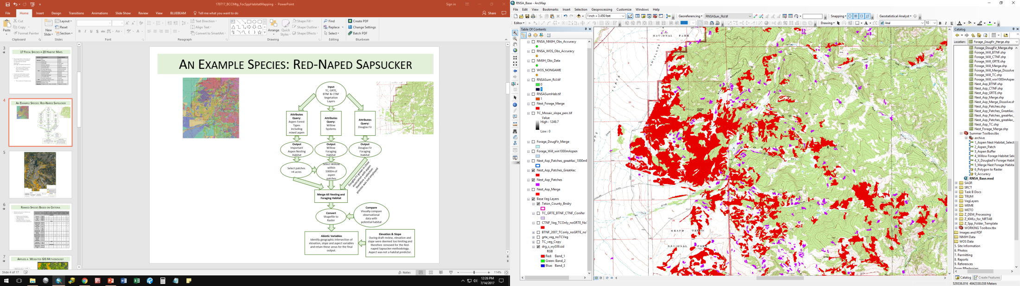
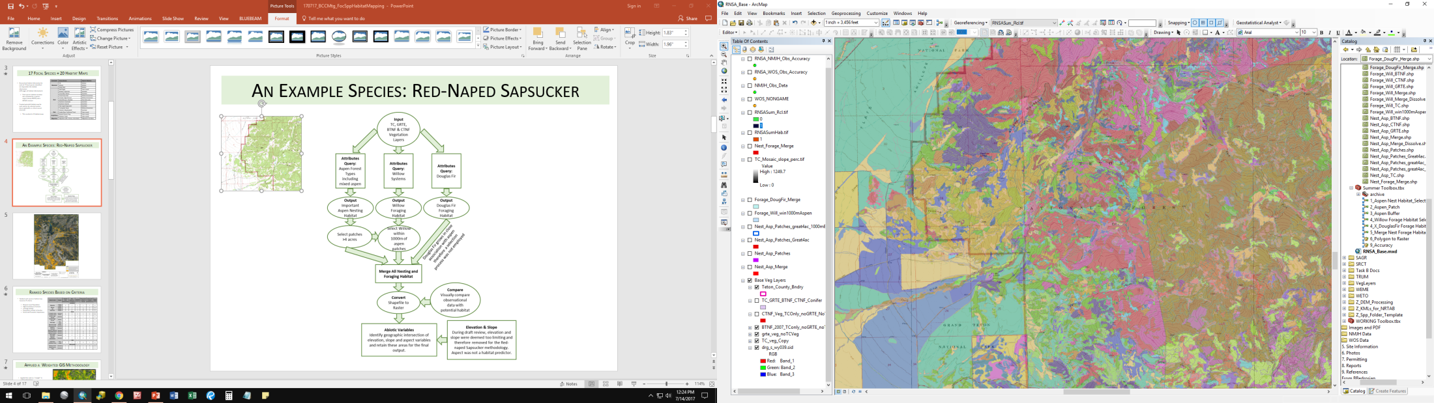
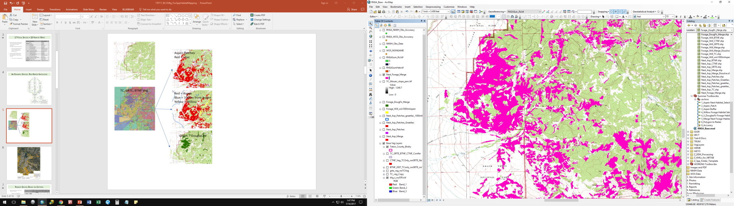
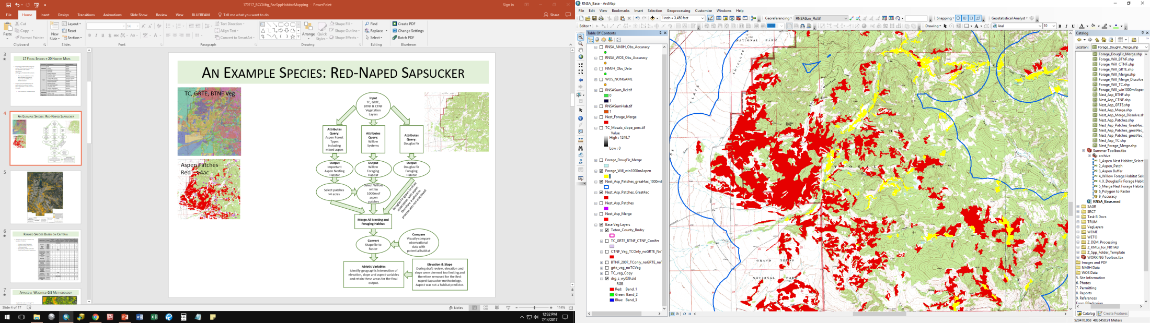
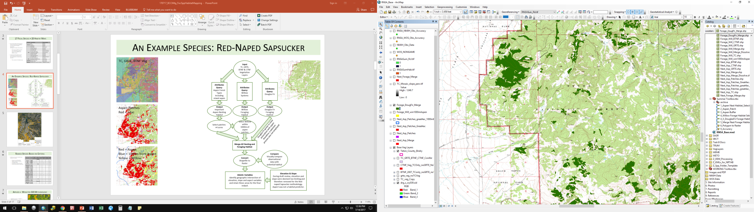
Example Species: Red-Naped Sapsucker
Aspen Patches
Red = >4ac
TC, GRTE, BTNF Veg
Red = Aspen
Blue = 1000m from Aspen
Yellow = Willow
Green = Douglas Fir

Slide 10
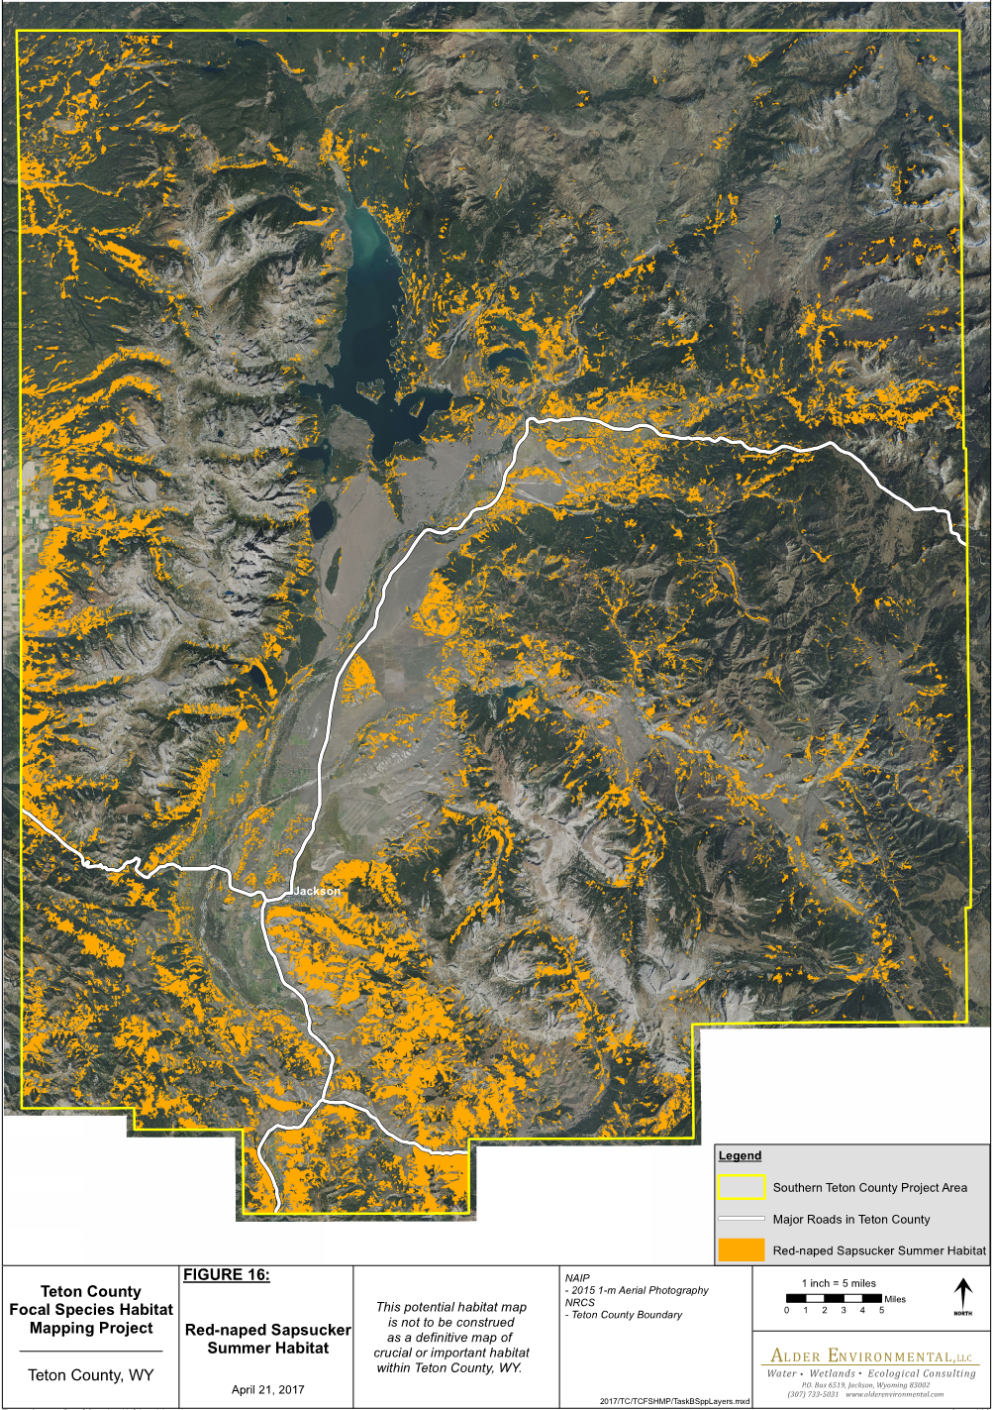
Example Species: Red-Naped Sapsucker

Slide 11
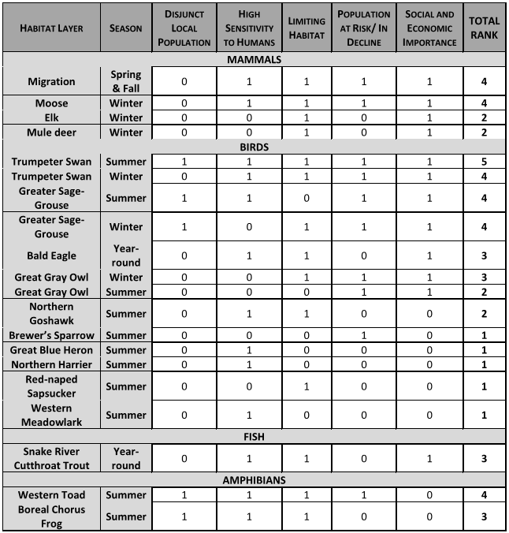
Professionals ranked each species habitat map based on 5 criteria:
Disjunct Local Population
High Sensitivity to Humans
Limiting Habitat
Population at Risk/ In Decline
Social and Economic Importance
Ranked Species Based on Criteria

Slide 12
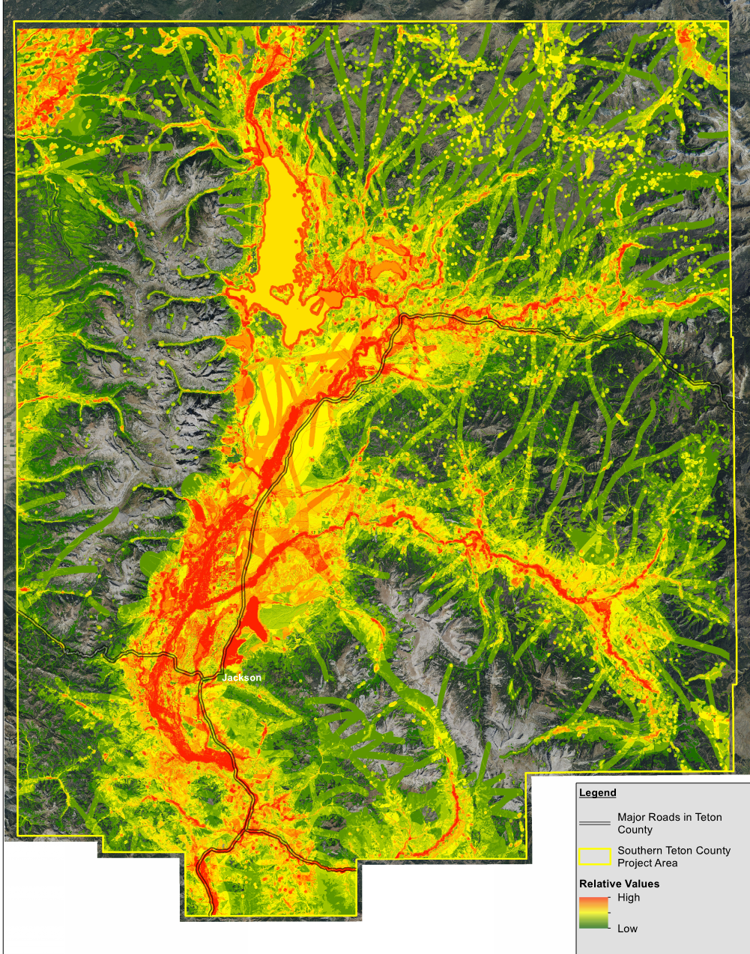
GIS Methodology
Applied the rank as a “weight” in a GIS methodology
Created Relative Values Habitat Map by adding all species habitat maps together.
Weighted Species Maps
1
Brewer’s Sparrow
2
Great Grey Owl – Summer
Red-naped Sapsucker
1
5
Trumpeter Swan– Summer
7
8
9
2
2
Relative Values Map

Slide 13
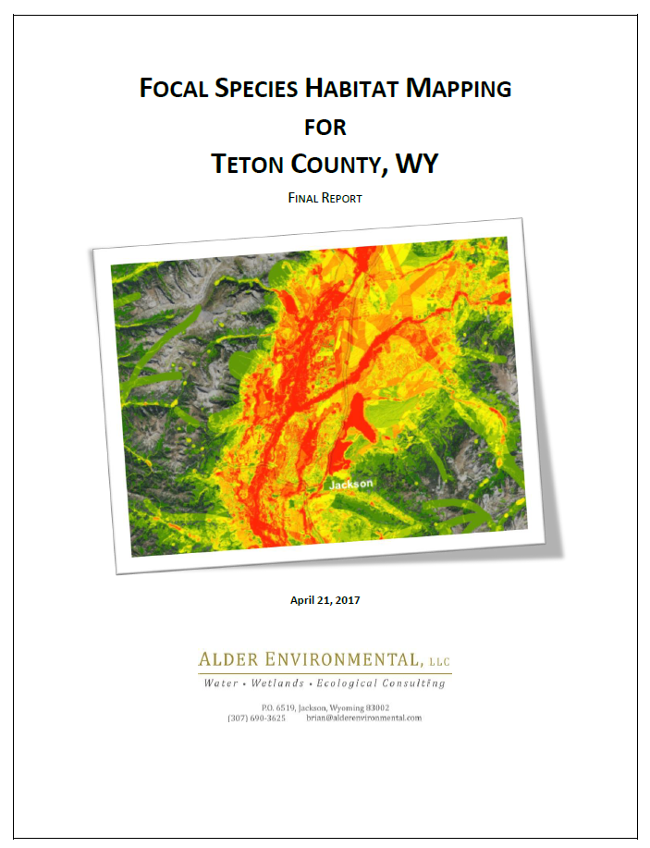

Slide 14
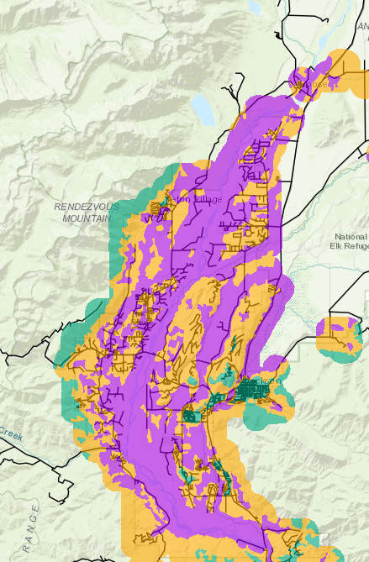
2023-2024
Tiers were created
Base – more development/ fewer habitat types or support fewer focal species
Mid – moderate number of habitat types, support more focal species, contain creeks if not within high tier
High – multiple habitat types, support multiple focal species, less development likely present
Draft LDR revised text
Correspond to Tiered NRO
Incorporate Permeability, Wildlife Movement and Migrations in text

Slide 15
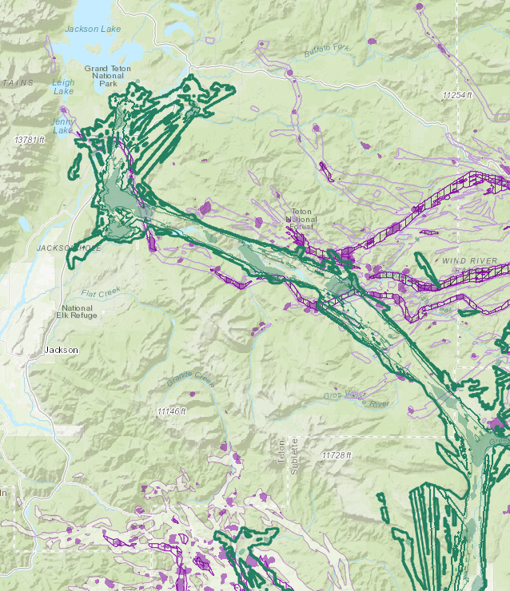
Permeability, Movement & Migration
Comp Plan Directive Policy 1.1.c Design for wildlife permeability
2018 Migration removed from data layers
Fundamentally different data set today
2024 Improved layers are now available
Overlay – population level data

Slide 16
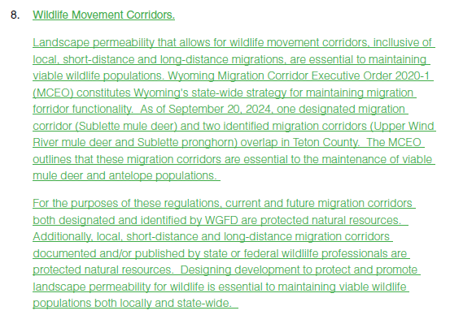
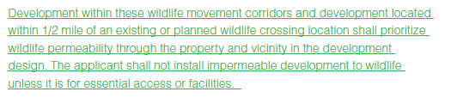
Permeability, Movement & Migration
Page 5-13 in Draft

Slide 17
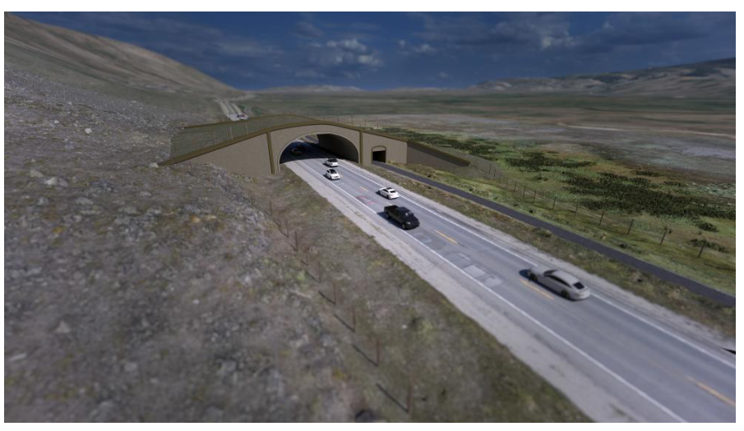

Permeability, Movement & Migration
Investments in wildlife crossings
½ mile radius around distinct locations
Landscape permeability for wildlife
Development designed for wildlife permeability is effective implementation

Slide 18
Waterbody & Wetland Setbacks
2018 Draft received stakeholder input
Some edits proposed, although not a full overhaul
River and Wetland setback buffer distance unchanged in draft
Streams:
Revised for consistency & predictability – change to 100 feet
Ephemeral – change to 30 feet (matching wetland)
Natural Lake/Pond – change to 100 feet
Additional Edits included:
Definitions for clarity
Removal of 3 cfs requirement for stream

Slide 19
Plan Review Committee
Not included in LDRs (as formal process)
Internal process
Approximately 40 agencies currently on PRC list
Each application unique – only sent to agencies where there may be impact / change / interest
Required PRC could initiate between 50 to 100 applications per year being sent out to agencies without the capacity to handle such a volume of requests in a timely manner
Planning Director and Principal Planner in Current Planning working on internal policy/program

Slide 20
Public Lands - Applicability
Sec. 1.5.3.b governs:
“Physical development, use, exercise of development options and subdivision by the State of Wyoming, the federal government, and all other government entities and their respective agencies, shall comply with the procedures and standards of these LDRs to the extent permitted by law.”
Staff Recommends adding to end of Sec 5.2.C.2
“2. Establishment of the Tiered Natural Resources Overlay Map
There is hereby established the Tiered Natural Resources Overlay Map, which shall overlay all zones established by these LDRs. “
ADD - “All lands within Teton County are within the Tiered Natural Resources Overlay. If any land is omitted from the map, it shall be considered as being within the Mid Tier for the purposes of these Land Development Regulations. Lands owned by government entities shall be subject to the NRO processes in these Land Development Regulations in accordance with Sec 1.5.3. Application to Government Entities.”

Slide 21
Other Minor Amendments
Edits to other sections for consistency of numbering
Current uses which are not allowed in the NRO in R-1 zone have been amended to state “not allowed within the High Tier” of the NRO (i.e. campground, assembly, daycare/education & aviation)
Table of edits page 46 of packet

Slide 22
Public Comment
Additional Questions ?
Edits ?
Recommendation
OR Continue to next Meeting?

Slide 23
Suggested Motions
LDR Text Amendment AMD2024-0001
I move to recommend APPROVAL of AMD2024-0001, including minor amendments, as presented in the draft dated October 22, 2024, to update the Natural Resources Overlay, being able to make the findings of LDR Section 8.7.1. as recommended by the Planning Director.
Zoning Map Amendment ZMA2024-0001
I move to recommend APPROVAL of ZMA2024-0001 as presented in the staff report dated October 14, 2024, to amend the Natural Resources Overlay and apply the updated three tiers as shown in the map, being able to make the findings of LDR Section 8.7.2. as recommended by the Planning Director.

