Slide 1
AMD2020-0001: LDR Text Amendment for Outdoor Reception Sites
June 29, 2020
Virtual Open House
Jackson & Teton County Long Range Planning

Slide 2
Background
Requested Action: Proposal to amend the Teton County Land Development Regulations (LDRs) that regulate outdoor reception events
Applicant: Teton County
Location: County-wide

Slide 3
Objective
Outdoor Event Site
Use Impacts
Is intensity of use compatible
with character of area?
Mitigation measures?
Public process?
= Conditional Use Permit
Health & Safety Impacts
Multi-dept clearinghouse
Resource availability
Health and safety of attendees
= Special Event Certificate

Slide 4
Proposal
Add “Special Event” as a Temporary Use.
For outdoor reception sites, clarify the definition of “private” and “non-profit” event exemptions.
For outdoor reception sites, expand the threshold for the requirement to obtain a Conditional Use Permit to include a single event annually that exceeds 300 attendees or an event that proposes on-site overnight camping as an incidental component of the primary reception site use.
Notes:
2. Private =
a gathering not open to the public hosted at a private home not renting their property to a third party specifically for the use of the reception/event site.
Non-profit = 501c3
3. In addition to current frequency (annual # of events > 3 metric thredhold for intensity of use), add size of event (# attendees > 300) and site occupancy period (overnight)

Slide 5
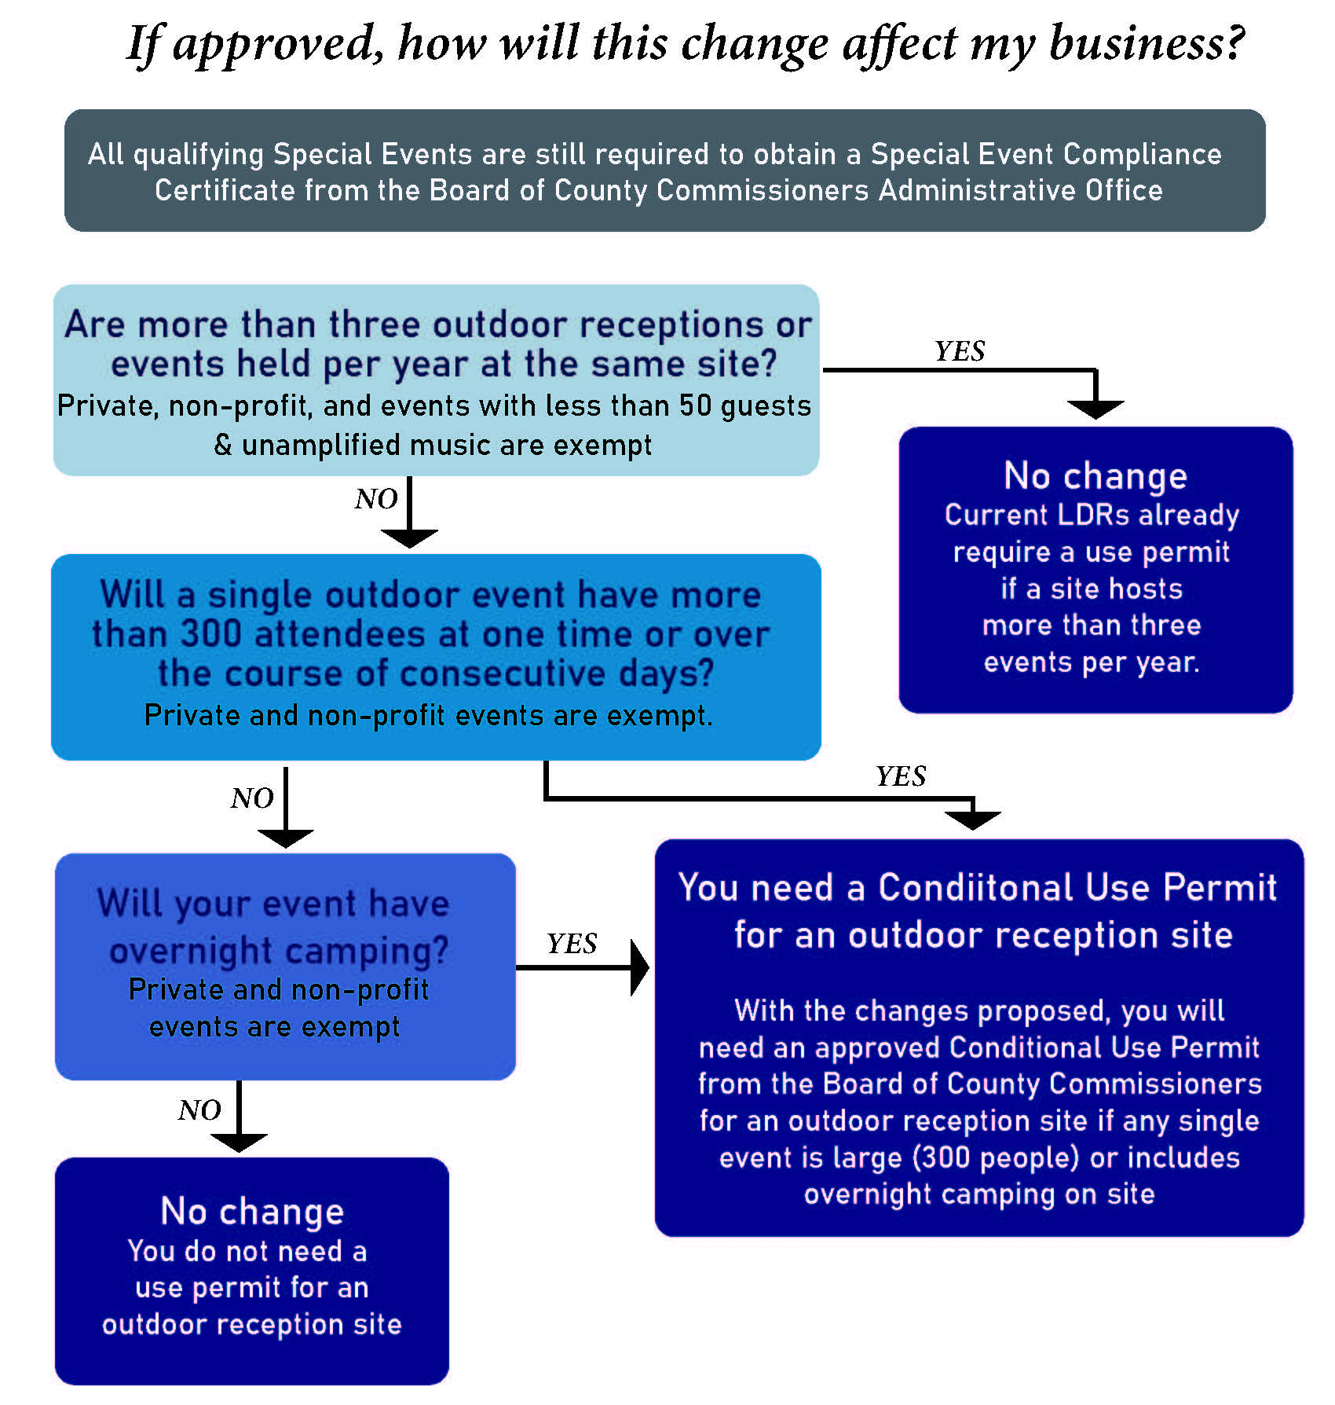
Impacts
Notes:
Exempted:
-already have CUP
-nonconforming use within nonconformity standards
-outside teton county jurisdiction
-Resort area/PUD Master Plan allows it

Slide 6
Background
CUP Process
$2500 County review fee
5-6-month review process
Two public hearings
Decision from BCC

Slide 7
Background
Alternatives
Postpone discussion and revisit after COVID-19
Adjust # of attendees threshold
Consider location attributes County-wide
Create new permit/review process specific to outdoor events, special events, or temporary uses
“Private” event could be broadened to any event that is invite-only and which public access is not provided.
A maximum attendance size restriction could be added

Slide 8
Background
More Info
Visit Jacksontetonplan.com
Project page:
https://www.jacksontetonplan.com/332/County-Outdoor-Event-Site-Regulations

Slide 9
Background
Process
Planning Commission (April): Recommended approval with reduced attendee threshold from 300 people to 175
Board of County Commissioners (May): Directed staff to do more outreach and review alternatives
July 7, 2020: Board of County Commissioners meeting

Slide 10
Background
Public Comment
Email to kmalone@tetoncountywy.gov
Attend July 7th 9:00 a.m. BCC hearing
BCC Chambers in County Admin building
Zoom
Notes:
Questions:
Effective date?
Private and non-profit definitions
Large event definition and # of attendees

