Slide 1

Town of Jackson
Downtown Parking Management Plan
10/24/18 Wort Hotel @ 6.00-8.00 pm

Slide 2

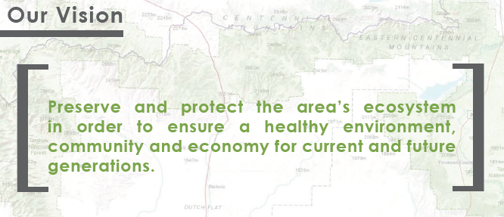

Slide 3

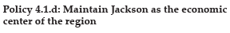
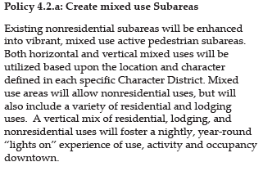





Slide 4





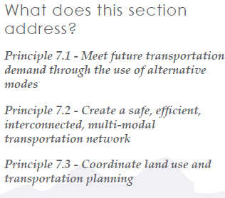



Slide 5
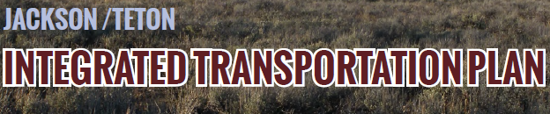
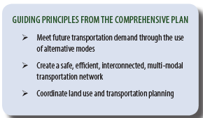
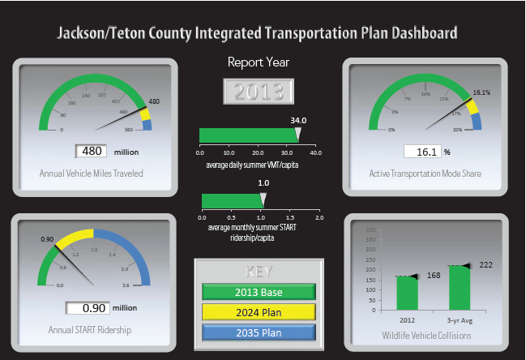

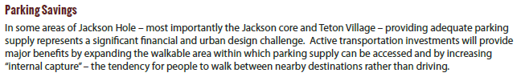


Slide 6

Purpose and Need
Parking is a significant land use that affects what can actually be built in the denser areas of the Town and County.
Parking availability and location is a key influencer of transportation decisions.
Parking management has a major impact on public works operations.
A comprehensive parking strategy that balances land use, transportation, and operations impacts is crucial to the implementation of the community’s goals.

Slide 7
The Parking Study will be comprised of 4 projects:
Residential, Non-Downtown Commercial
Downtown Core Parking Study
Regional Corridor Parking Study
Communitywide TDM Scoping
Common tasks:
Task 1a: Parking Inventory and Utilization
Task 1b: Level of Service Documentation
Task 1c: Alternative Development/Review
Task 1d: Recommended Alternative

Slide 8
Downtown Parking Management Scope of Work
The scope of work is broken down into the following six tasks:
Inventory and Utilization Update
Outreach Support
Parking Demand Management
Purpose of Public Parking Downtown
Recommended Alternative
Townwide Parking and Mobility Framework

Slide 9
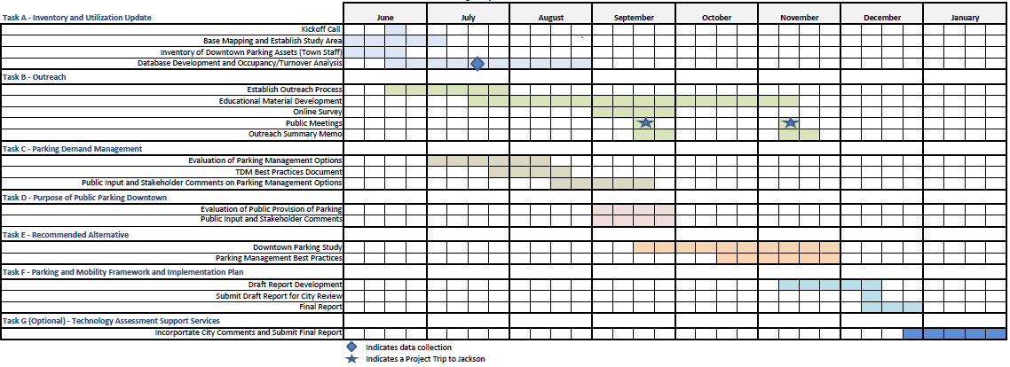
Timeline & Next Steps
November - Public Survey
December - January: Draft Plan Release – Public Meeting and Comment
February 2019 – Consideration of Plan by Town Council

Slide 10
Notes:
What type of Hillside Regulations are appropriate for Jackson? Does council want the Bronze level standard? The silver level standard or the Gold level standard?
Based on research of other communities and of best practices, Staff sees three elements common among "gold-level" hillside standards. These include
- Prescriptive methods – whereby regulations define in detail how to determine slope stability and safety. Much of this centers around how geotechnical reports are produced and includes submittal requirements for the report, certain analysis that must be performed, the specific best practice the must be followed, and a level of safety that must be proved.
- When methods are this specific, the regulations have to have a geological expert who reviews them. Thus, the second element of a gold-standard type of regulation is geological expertise. Some communities have that expert on staff, some contract out with them.
- Lastly, most communities who have this gold-level standard hillside regulations, carry out geohazard mapping that provides a more accurate trigger for when applicants need to follow the prescriptive methods outlined above.
- An example of a gold-standard hillside regulation would be Draper City, Ut. We included their regulations as an attachment for your reference.

